Slide 1
Joint ADA/EASD—Management of Hyperglycaemia in Type 2 Diabetes
Friday, September 23, 2022
12:15 – 13:45 CEST
Co-Chair: John B. Buse, MD, PhD
Co-Chair: Melanie J. Davies, MB ChB, MD
Davies MJ, Aroda VR, Collins BS, Gabbay RA, Green J, Maruthur NM, Rosas SE, Del Prato S, Mathieu C, Mingrone G, Rossing P, Tankova T, Tsapas A, Buse JB
Diabetes Care 2022; https://doi.org/10.2337/dci22-0034. Diabetologia 2022; https://doi.org/10.1007/s00125-022-05787-2.

Slide 2
Introduction
Melanie J. Davies, MB ChB, MD
Professor of Diabetes Medicine
University of Leicester UK
and
Honorary Consultant Diabetologist
University Hospitals of Leicester NHS Trust
.

Slide 3
Disclosures of Interest
Advisory Panel: Boehringer Ingelheim, Lilly, Novo Nordisk, Sanofi, Janssen, Lexicon, Pfizer & ShouTi Pharma Inc
Consultant: Boehringer Ingelheim, Lilly, Novo Nordisk & Sanofi
Research Support: Novo Nordisk, Sanofi-Aventis, Lilly, Boehringer Ingelheim, Astrazeneca & Janssen
Speaker’s Bureau: Boehringer Ingelheim, Lilly, Novo Nordisk, Sanofi, Janssen, Lexicon, Pfizer, ShouTi Pharma Inc., Napp Pharmaceuticals, Novartis & Takeda Pharmaceuticals International Inc.
Employee: None
Stocks/ Shareholder: none in any device or pharmaceutical company

Slide 4
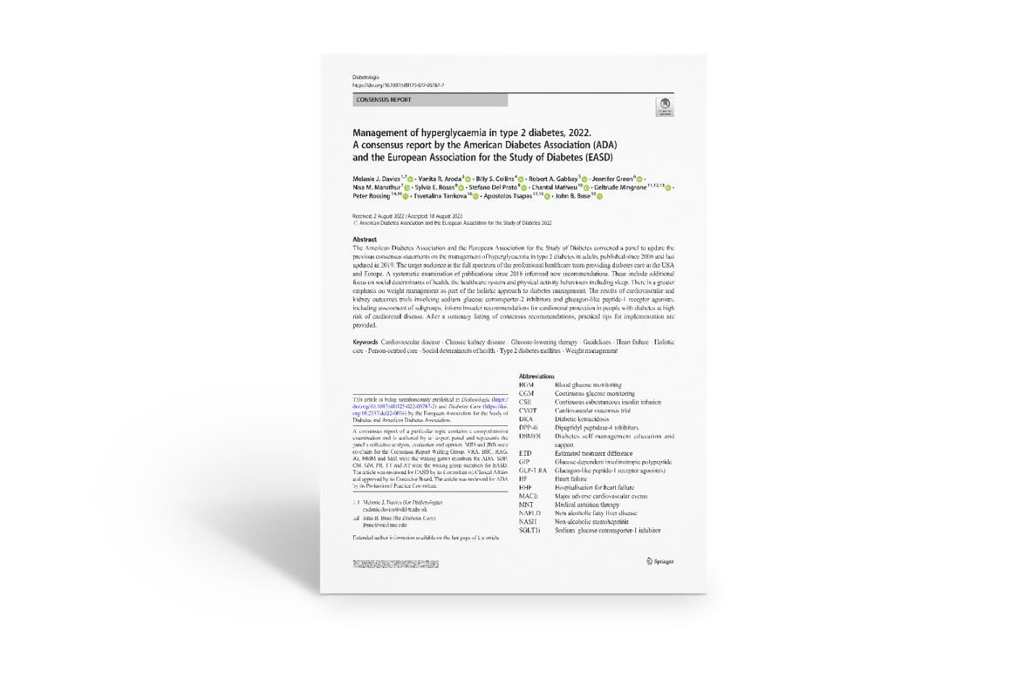
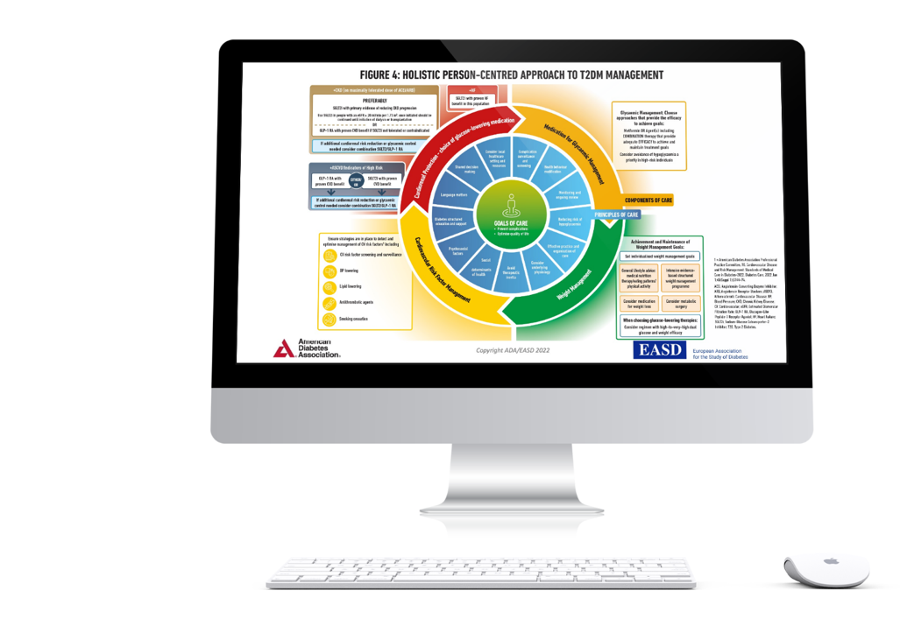
Papers will be simultaneously published and slide set will be available to download
Davies MJ, Aroda VR, Collins BS, Gabbay RA, Green J, Maruthur NM, Rosas SE, Del Prato S, Mathieu C, Mingrone G, Rossing P, Tankova T, Tsapas A, Buse JB
Diabetes Care 2022; https://doi.org/10.2337/dci22-0034. Diabetologia 2022; https://doi.org/10.1007/s00125-022-05787-2.

Slide 5










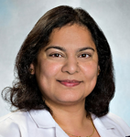


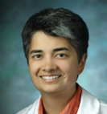


Co-Chair: Melanie J. Davies MB ChB, MD
University of Leicester, UK
Co-Chair: John B. Buse, MD, PhD
UNC School of Medicine, USA
The Rationale
Peter Rossing, MD
Steno Diabetes Center Copenhagen, Denmark
Billy Collins, DHSc, PA-C
U.S. Public Health Service, USA
Personalised Approach
Apostolos Tsapas, MD, PhD, MSc
Aristotle University Thessaloniki, Greece
Jennifer Green, MD
Duke University, Durham, USA
Project Oversight & Integration with SOC Mindy Saraco & Malaika Hill
ADA
Support Across Groups
Robert Gabbay, MD, PhD
ADA
Stefano Del Prato, MD
EASD
Strategies for Implementation
Chantal Mathieu, MD, PhD
KU Leuven, Leuven, Belgium
Nisa Maruthur, MD, MHS
Johns Hopkins Medicine, Baltimore, USA
Sylvia Rosas, MD, MSCE
Joslin Diabetes Center, Boston, USA
Therapeutic Options
Vanita Aroda, MD
Brigham & Women's Hospital, Boston, USA
Geltrude Mingrone, MD, PhD
Catholic University of the Sacred heart, Rome, Italy
Tsvetalina Tankova, MD, DSC
Medical University, Sofia, Bulgaria
Davies MJ, Aroda VR, Collins BS, Gabbay RA, Green J, Maruthur NM, Rosas SE, Del Prato S, Mathieu C, Mingrone G, Rossing P, Tankova T, Tsapas A, Buse JB
Diabetes Care 2022; https://doi.org/10.2337/dci22-0034. Diabetologia 2022; https://doi.org/10.1007/s00125-022-05787-2.

Slide 6
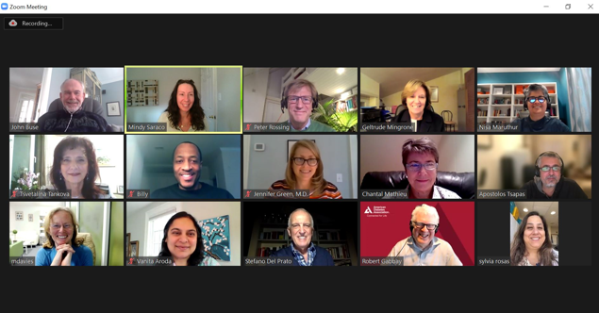


Methods
Teleconference Jan 2022
Three-day meeting in January 2022, via teleconference
Two-day in-person meeting in April, Amsterdam
Teleconferences every 1-4 weeks, September 2021 to present
Co-chairs and 4 sets of section authors
Evidence review informed the content
Amsterdam April 2022
Davies MJ, Aroda VR, Collins BS, Gabbay RA, Green J, Maruthur NM, Rosas SE, Del Prato S, Mathieu C, Mingrone G, Rossing P, Tankova T, Tsapas A, Buse JB
Diabetes Care 2022; https://doi.org/10.2337/dci22-0034. Diabetologia 2022; https://doi.org/10.1007/s00125-022-05787-2.

Slide 7
Overview
The Rationale, Importance, and Context of Glucose-Lowering Treatment
Billy Collins, DHSc, PA-C & Peter Rossing, MD
Therapeutic Options: Lifestyle and Healthy Behaviour, Weight Management, and Pharmacotherapy for the Treatment of Type 2 Diabetes
Vanita Aroda, MD, Geltrude Mingrone, MD, PhD, & Tsvetalina Tankova, MD, PhD
Personalised Approach to Treatment Based on Individual Characteristics and Comorbidities
Jennifer Green, MD & Apostolos Tsapas, MD, PhD, MSc
Putting it All Together: Strategies for Implementation
Nisa Maruthur, MD, MHS, Sylvia Rosas, MD, MSCE, & Chantal Mathieu, MD, PhD
Key Knowledge Gaps and A Call to Action
John B. Buse, MD, PhD

Slide 8
Methods
The writing group accepted the 2018 edition and 2019 update of this consensus report as a starting point for the evidence search.
To identify newer evidence, a search was conducted on PubMed for randomized clinical trials (RCTs), systematic reviews, and meta-analyses published in English between January 28, 2018, and December 12, 2021.
Eligible publications examined the effectiveness or safety of pharmacologic or non-pharmacologic interventions in adults with type 2 diabetes mellitus.
Reference lists were scanned in eligible reports to identify additional articles relevant to the subject.
Details on the keywords and the search strategy are accessed via a link in the papers.
Papers were grouped according to subject; the authors reviewed this new evidence to inform the consensus recommendations.
We updated the search to June 13th 2022.
Davies MJ, Aroda VR, Collins BS, Gabbay RA, Green J, Maruthur NM, Rosas SE, Del Prato S, Mathieu C, Mingrone G, Rossing P, Tankova T, Tsapas A, Buse JB
Diabetes Care 2022; https://doi.org/10.2337/dci22-0034. Diabetologia 2022; https://doi.org/10.1007/s00125-022-05787-2.

Slide 9
Literature review
Search Strategy (PubMed)
#1) 1 AND 2 NOT (3 OR 4 OR 5 OR 6 OR 7) AND (8 OR 9) NOT (10 OR 11 OR 12)
#2) 13 AND 14 AND (15 OR 16 OR 17)
#1 OR #2
Categories | String | #
Population | Diabetes[Title/Abstract] | 1
 | Type 2[Title/Abstract] | 2
 | Animal*[Title/Abstract] | 3
 | Mice[Title] | 4
 | Mouse[Title] | 5
 | Rat*[Title] | 6
 | Comment*[Title] | 7
Design/Intervention | Random*[Title/Abstract] | 8
 | Trial*[Title/Abstract] | 9
 | Review[ptyp] | 10
 | Pharmacodynamic*[Title] | 11
 | Pharmacokinetic*[Title] | 12
Categories | String | #
Population | Diabetes[Title/Abstract] | 13
 | Type 2[Title/Abstract] | 14
Design/Intervention | Meta[Title] | 15
 | Indirect[Title] | 16
 | Mixed[Title] | 17
Davies MJ, Aroda VR, Collins BS, Gabbay RA, Green J, Maruthur NM, Rosas SE, Del Prato S, Mathieu C, Mingrone G, Rossing P, Tankova T, Tsapas A, Buse JB
Diabetes Care 2022; https://doi.org/10.2337/dci22-0034. Diabetologia 2022; https://doi.org/10.1007/s00125-022-05787-2.

Slide 10
Key points to emphasise
Informed by evidence generated in the past 3 years
Greater focus on social determinants of health and systems and equality of care
Emphasis on holistic person-centred care
Greater focus on weight goals as an essential component of comprehensive care
Consolidation of evidence from CVOTs
Davies MJ, Aroda VR, Collins BS, Gabbay RA, Green J, Maruthur NM, Rosas SE, Del Prato S, Mathieu C, Mingrone G, Rossing P, Tankova T, Tsapas A, Buse JB
Diabetes Care 2022; https://doi.org/10.2337/dci22-0034. Diabetologia 2022; https://doi.org/10.1007/s00125-022-05787-2.

Slide 11
This is a consensus report
The 346 references included in the manuscript are not listed here in the data presented today.
Though evidence based, the recommendations presented reflect the values and preferences of the authors.
Not everyone agreed with every point. As a point of process, we agreed in advance that we would vote on areas of disagreement and proceed on basis of super-majority (60%), though that never came to pass.

Slide 12
Review Process
The draft Consensus was presented at the ADA in June 2022
Feedback after the ADA presentation (>450 comments)
Diabetes Care and Diabetologia editors invited reviewers as well as;
ADA’s Professional Practice Committee
EASD’s Committee of Clinical Affairs
All comments were evaluated by the writing team and informed the papers simultaneously published and presented today in Diabetes Care and Diabetologia

Slide 13
Acknowledgements
From Leicester Diabetes Centre, the University of Leicester and the NHS Hospital Trust (UHL University of Leicester NHS Trust):
Michael Bonar
Charlie Franklin
Shehnaz Jamal
Francesco Zaccardi
Joe Henson
Tom Yates
From Aristotle University Thessaloniki
Thomas Karagiannis
ADA
Nuha El Sayed
Malaika Hill
Raveendhara R. Bannuru, MD, FAGE
Nuha El Sayed, MD, MMSc
EASD
Petra Niemann
Natasha Buckley-Muehge
Invited Reviewers
CCA of the EASD
PPC of the ADA

Slide 14
The Rationale, Importance, and Context of Glucose-Lowering Treatment
Peter Rossing, MD, DMSc* and Billy Collins, DHSc, PA-C#
for the ADA-EASD Management of Hyperglycaemia in Type 2 Diabetes Working Group
*Professor University of Copenhagen, Head of Complications Research, Steno Diabetes Center Copenhagen, Denmark
#Associate Investigator, Director of Clinical Services, Social Determinants of Obesity and Cardiovascular Risk Laboratory, National Heart, Lung & Blood Institute, NIH
Davies MJ, Aroda VR, Collins BS, Gabbay RA, Green J, Maruthur NM, Rosas SE, Del Prato S, Mathieu C, Mingrone G, Rossing P, Tankova T, Tsapas A, Buse JB
Diabetes Care 2022; https://doi.org/10.2337/dci22-0034. Diabetologia 2022; https://doi.org/10.1007/s00125-022-05787-2.
Notes:
Good afternoon. My name is CDR Billy Collins and I work as a Health Scientist for the National Institutes of Health. Dr. Rossing and I will discuss the rationale, importance and context of glucose lowering treatment.

Slide 15
Disclosures of Interest
Billy Collins
Nothing to disclose
My input into this Consensus Report is from my own perspective and the Report does not reflect the view of the National Institutes of Health, Department of Health and Human Services, or the U.S. Government.
.

Slide 16
Disclosures of Interest
Peter Rossing declares the following:
Consultancy and/or speaking fees: (to his institution) Astellas Pharma, AstraZeneca, Bayer AG, Boehringer Ingelheim, Eli Lilly, MSD, Novo Nordisk and Sanofi Aventis
Research grants: AstraZeneca and Novo Nordisk
Stocks/ Shareholder: None

Slide 17
Goals of Diabetes Care
Prevent complications
Optimise quality of life
Davies MJ, Aroda VR, Collins BS, Gabbay RA, Green J, Maruthur NM, Rosas SE, Del Prato S, Mathieu C, Mingrone G, Rossing P, Tankova T, Tsapas A, Buse JB
Diabetes Care 2022; https://doi.org/10.2337/dci22-0034. Diabetologia 2022; https://doi.org/10.1007/s00125-022-05787-2.
Notes:
The primary goal of diabetes care is to prevent complications through effective management and treatment. We do this in the spirit of hoping to improve overall health and quality of life in the presence of disease.

Slide 18
Preventing Complications
Glycaemic Management
Cardiovascular Risk Factor Management
Cardiorenal protection – glucose lowering agents
CVD Risk Reduction
Weight Management
Davies MJ, Aroda VR, Collins BS, Gabbay RA, Green J, Maruthur NM, Rosas SE, Del Prato S, Mathieu C, Mingrone G, Rossing P, Tankova T, Tsapas A, Buse JB
Diabetes Care 2022; https://doi.org/10.2337/dci22-0034. Diabetologia 2022; https://doi.org/10.1007/s00125-022-05787-2.
.
Notes:
Preventing complications require glucose control.
Effective glucose control oftentimes require prescribing glucose lowering agents that can in turn provide cardio-renal protection.
Weight management is a critically important aspect of disease management, which in turn, helps to mediate cardiovascular risk and related complications.

Slide 19
Language matters
Communication between people living with type 2 diabetes and health care team members is at the core of integrated care
Clinicians must recognise how language matters
Language in diabetes care should be neutral, free of stigma, and based on facts; be strengths-based (focus on what is working), respectful, and inclusive; encourage collaboration; and be person-centred
People living with diabetes should not be referred to as “diabetics,” or described as “noncompliant,” or blamed for their health condition.
Davies MJ, Aroda VR, Collins BS, Gabbay RA, Green J, Maruthur NM, Rosas SE, Del Prato S, Mathieu C, Mingrone G, Rossing P, Tankova T, Tsapas A, Buse JB
Diabetes Care 2022; https://doi.org/10.2337/dci22-0034. Diabetologia 2022; https://doi.org/10.1007/s00125-022-05787-2.
.
Notes:
Language matters when communicating with people living with T2D. It is a core element of integrated core.
Providers must acknowledge it and work to communicate in a respectful way, that is both factual and free of stigma.
We must avoid using terms that are perceived as offensive, filled with stigma, considered derogatory, or alludes to the notion of casting blame on the person with diabetes.
The health care team is in place to help and encourage, and that message must be clearly communicated by using effective language.

Slide 20
Social Determinants of Health
SDOH must be addressed to improve health outcomes
Five SDOH areas have been identified:
  socioeconomic status (education, income, and occupation),
  living and working conditions,
  multisector domains (e.g., housing, education, criminal justice system),
  sociocultural context (e.g., shared cultural values, practices, experiences), and
  sociopolitical context (e.g., societal and political norms that are root-cause ideologies and policies underlying health disparities)
Environmental, social, behavioural, and emotional factors, known as psychosocial factors, influence living with diabetes, and achieving satisfactory medical outcomes and psychological well-being
Individuals’ heterogeneity, SDOH, and psychosocial factors challenge individuals with diabetes, their families, and their providers when attempting to integrate diabetes care into daily life
Davies MJ, Aroda VR, Collins BS, Gabbay RA, Green J, Maruthur NM, Rosas SE, Del Prato S, Mathieu C, Mingrone G, Rossing P, Tankova T, Tsapas A, Buse JB
Diabetes Care 2022; https://doi.org/10.2337/dci22-0034. Diabetologia 2022; https://doi.org/10.1007/s00125-022-05787-2.
.
Notes:
This is often a challenging conversation because of the co-morbidities and polypharmacy that people with diabetes often live with day-to-day.
As a way to help improve health outcomes, the SDoH must be addressed.
Management decisions require that clinicians consider multiple socially important factors that have proven to influence a person’s health.
The 5 areas listed here should be addressed and taken into consideration when developing individualized plans of care.
Diversification in living and working conditions, cultural and personal values, and psychosocial/behavioural concerns must be identified and adequately addressed when working to improve the health of people with diabetes.

Slide 21
Importance of Glycaemic Control
Averting symptomatic hyperglycaemia
Substantial and enduring reduction in microvascular complications
  50-76% reduction DCCT with HbA1c 7% vs 9%
  25% reduction UKPDS with HbA1c 7% vs 7.9%
  Greatest benefit with reduction from higher levels of HbA1c
Uncertainty regarding macrovascular benefit of BG control in T2D
Benefits emerge slowly while harms of glucose control medications can be more immediate
Davies MJ, Aroda VR, Collins BS, Gabbay RA, Green J, Maruthur NM, Rosas SE, Del Prato S, Mathieu C, Mingrone G, Rossing P, Tankova T, Tsapas A, Buse JB
Diabetes Care 2022; https://doi.org/10.2337/dci22-0034. Diabetologia 2022; https://doi.org/10.1007/s00125-022-05787-2.
.
Notes:
Glycemic control yields immediate benefits in reducing symptoms such as thirst, polyuria, blurred vision and fatigue. These symptoms are commonly associated with poor control. But beyond immediate symptom relief, substantial microvascular benefits emerge and increase over time.
The evidence that the burden of microvascular complications of diabetes can be significantly reduced by early, rigorous, therapeutic intervention is unequivocal. Risk reductions of 50-76% were seen in people with T1D studied in DCCT. UKPDS confirmed the importance of glycemic control for microvascular risk reduction in T2D. Epidemiologic analysis of the UKPDS data showed that for every 1% reduction in A1C, the relative risk for microvascular complications decreased by 37%. The greatest benefit comes from improving control in those with the highest A1C and are at the highest risk of complications.
Because macrovascular benefits emerged after the randomized intervention period, there is uncertainty regarding macrovascular benefit of BG control in T2D.

Slide 22
Glucose Control: Monitoring
HbA1c test
  Excellent performance in certified labs
  Limitations in conditions that alter red blood cell turnover and in certain racial and ethnic groups
  Consider reliability of HbA1c assay with discrepancies between measured HbA1c and glucose levels
Blood glucose monitoring
  Useful for self-management in people with type 2 diabetes particularly when taking insulin
  Limited benefit outside insulin Rx and adds burden and cost
  Continuous glucose monitoring (CGM) provide more information and may be useful for people with type 2 diabetes, particularly those using insulin
Davies MJ, Aroda VR, Collins BS, Gabbay RA, Green J, Maruthur NM, Rosas SE, Del Prato S, Mathieu C, Mingrone G, Rossing P, Tankova T, Tsapas A, Buse JB
Diabetes Care 2022; https://doi.org/10.2337/dci22-0034. Diabetologia 2022; https://doi.org/10.1007/s00125-022-05787-2.
Notes:
Glycemic control is primarily assessed with the A1C test, which was the measure studied in trials demonstrating the outcomes benefit of glucose lowering. The performance of the test is generally excellent for “certified” assays and laboratories. As with any laboratory test, A1C has limitations, particularly in people with conditions that alter RBC turnover such as anemia or late-stage CKD. Or if an assay with interference from a variant hemoglobin is used in a carrier of that variant. When there is a discrepancy between measured A1C and glucose levels, consideration should be given to the reliability of the A1C assay in that person. Self-monitoring blood glucose can help people on insulin with self-management and medication adjustment. Self-monitoring plans should be individualized, and the data used by the person and the health care team in an effective and timely manner. Routine clinical monitoring is of limited clinical benefit in those not on insulin and adds burden and cost. The role of newer technologies such as CGM in T2D management remains to be established.

Slide 23
Improving Glycaemic Management
Focus on treatments for glycaemic management
  Behavioural approaches
  Medications
  Metabolic surgery
Addresses increasing complexity of person-centred therapeutic decisions in the context of expanding therapeutic options and new information on benefits and risks
Davies MJ, Aroda VR, Collins BS, Gabbay RA, Green J, Maruthur NM, Rosas SE, Del Prato S, Mathieu C, Mingrone G, Rossing P, Tankova T, Tsapas A, Buse JB
Diabetes Care 2022; https://doi.org/10.2337/dci22-0034. Diabetologia 2022; https://doi.org/10.1007/s00125-022-05787-2.
.
Notes:
Large proportions of the population with T2D are not at glycemic goal. Thus, it is imperative that we develop improved approaches to therapies and that we empower people and providers to effectively use the increasing number and variety of tools available to achieve glycemic control. Lifestyle remains the foundation of therapy both for BG control and CV risk reduction. We know from LookAHEAD and other studies that behavioral therapy targeting weight loss can reduce the need for medication to control BG, BP and lipids and yield numerous other benefits, such as improved QOL. Yet this essential component of diabetes care remains challenging to implement.
BG lowering agents differ in their benefits and risks, cost, and ease of administration. Tailoring their use based on person factors and preferences is a major focus of this report. Metabolic surgery also improves BG control with reduced need for anti-hyperglycemic therapy.
The ever-expanding array of therapeutic options and new information on benefits and risk of therapeutic modalities, increase the complexity of person- centered therapeutic decision making. This report provides up to date information on benefits and risks of therapies and guidance on when and how to deploy them.

Slide 24
Weight Reduction as a Targeted Intervention
Weight reduction has mostly been seen as a strategy to improve glycaemic management and reduce the risk for weight-related complications.
It was recently suggested that weight loss of 5-15% should be a primary target in management for many people living with type 2 diabetes.
A higher magnitude of weight loss confers better outcomes, and a 5-10% loss confers metabolic improvement, and a loss of 10-15% or more of body weight can have a disease-modifying effect, and lead to remission of diabetes.
Weight loss may exert benefits that extend beyond glycaemic management to improve risk factors for cardiometabolic disease and quality of life.
Davies MJ, Aroda VR, Collins BS, Gabbay RA, Green J, Maruthur NM, Rosas SE, Del Prato S, Mathieu C, Mingrone G, Rossing P, Tankova T, Tsapas A, Buse JB
Diabetes Care 2022; https://doi.org/10.2337/dci22-0034. Diabetologia 2022; https://doi.org/10.1007/s00125-022-05787-2.
Notes:
Weight reduction, as a targeted intervention, has largely been viewed as a strategy to improve glycemic control, and minimize weight-related complications. 5-15% weight loss reduction is considered by some to be a viable target for those living with T2D. While more weight loss can improve outcomes and have a disease modifying effect, weight loss in general has benefits that extend well beyond glycemic control and has been associated with an improved overall quality of life.
I will now hand it off to Dr. Rossing…..

Slide 25

Putting the Person with Diabetes at the Centre of Care
Davies MJ, Aroda VR, Collins BS, Gabbay RA, Green J, Maruthur NM, Rosas SE, Del Prato S, Mathieu C, Mingrone G, Rossing P, Tankova T, Tsapas A, Buse JB
Diabetes Care 2022; https://doi.org/10.2337/dci22-0034. Diabetologia 2022; https://doi.org/10.1007/s00125-022-05787-2.

Slide 26
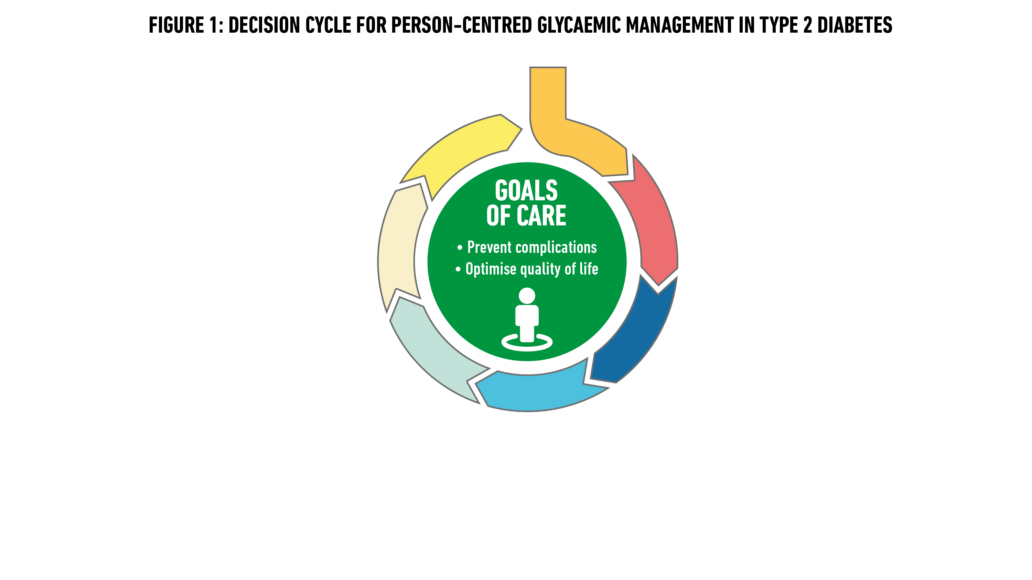
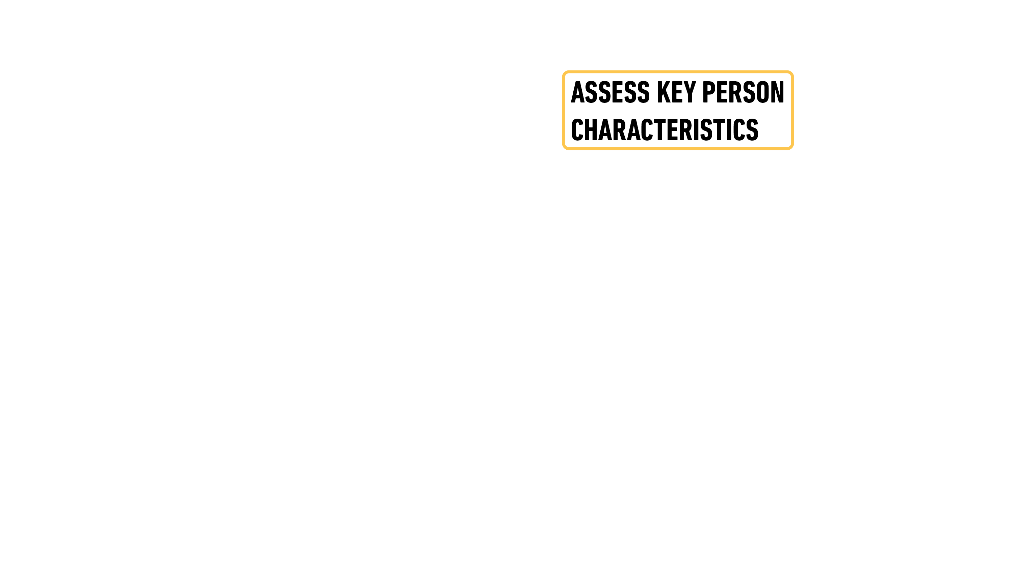


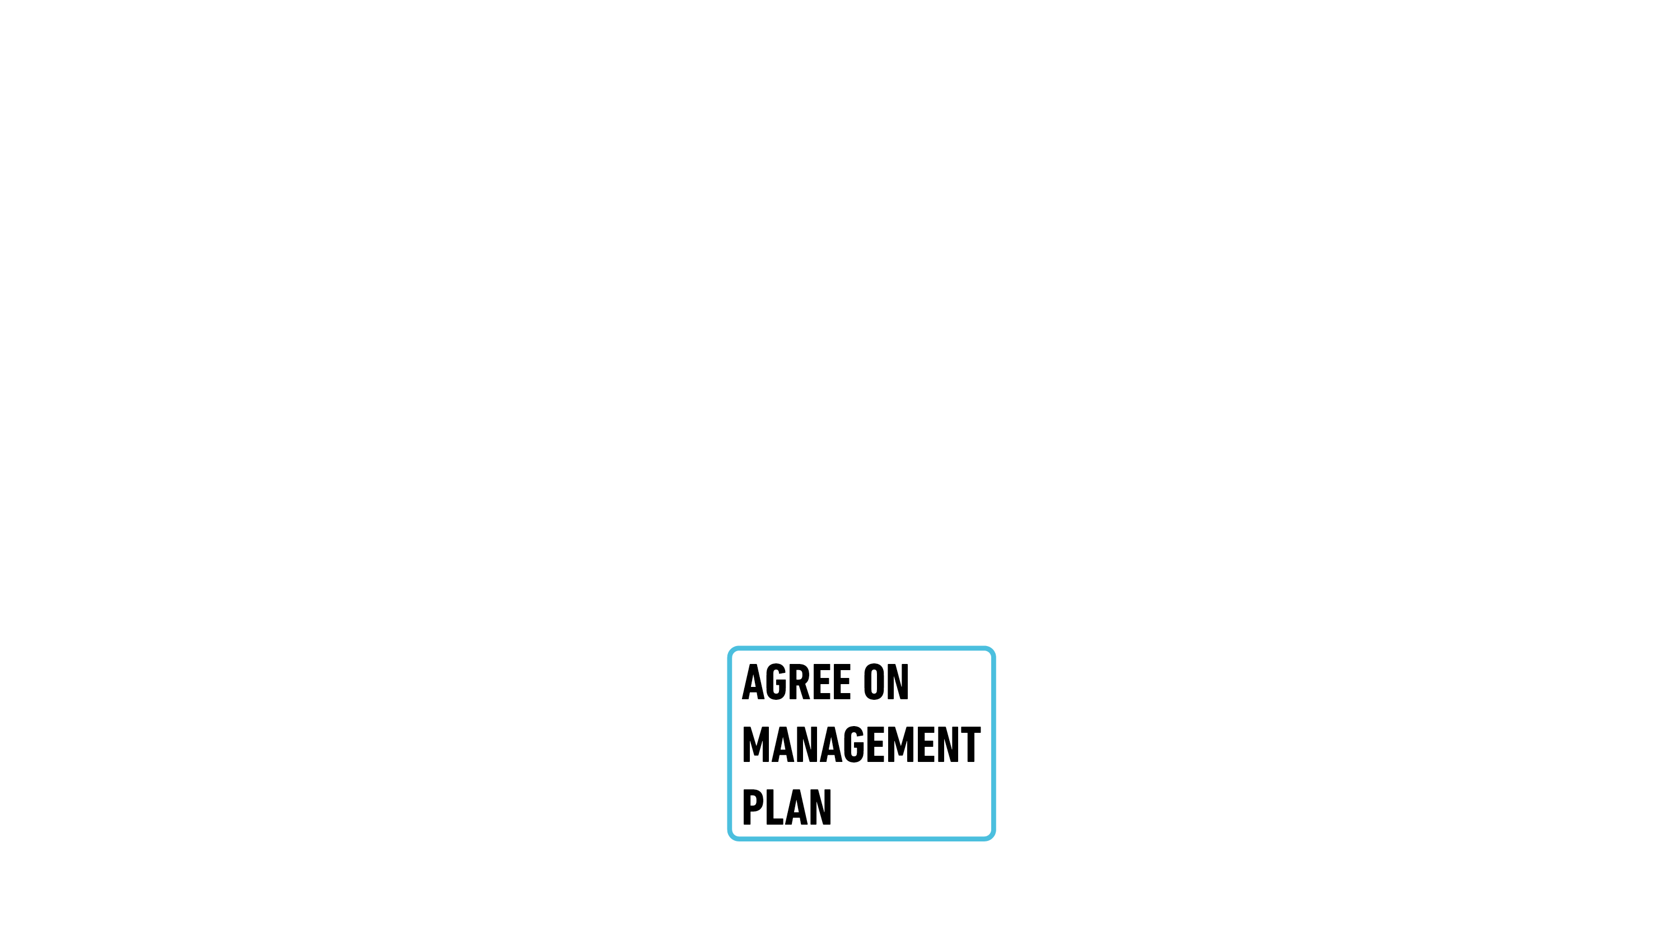



Davies MJ, Aroda VR, Collins BS, Gabbay RA, Green J, Maruthur NM, Rosas SE, Del Prato S, Mathieu C, Mingrone G, Rossing P, Tankova T, Tsapas A, Buse JB
Diabetes Care 2022; https://doi.org/10.2337/dci22-0034. Diabetologia 2022; https://doi.org/10.1007/s00125-022-05787-2.
.

Slide 27
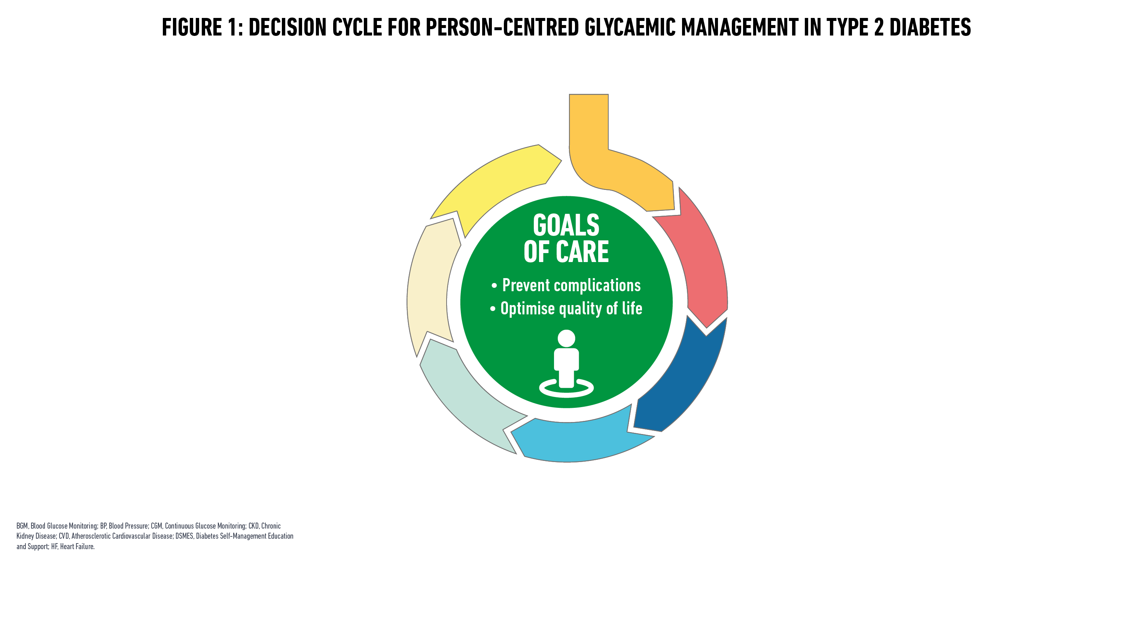
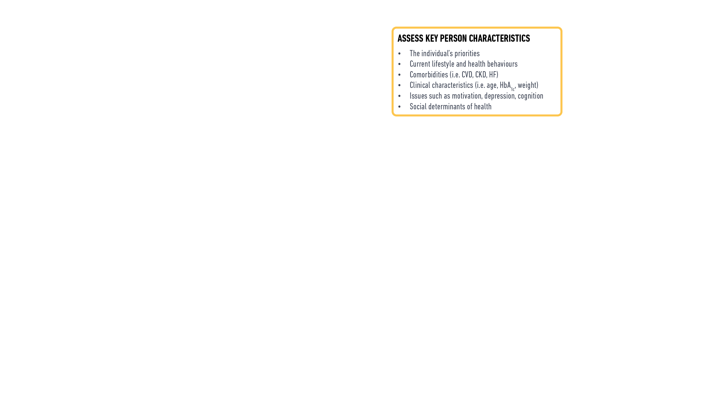
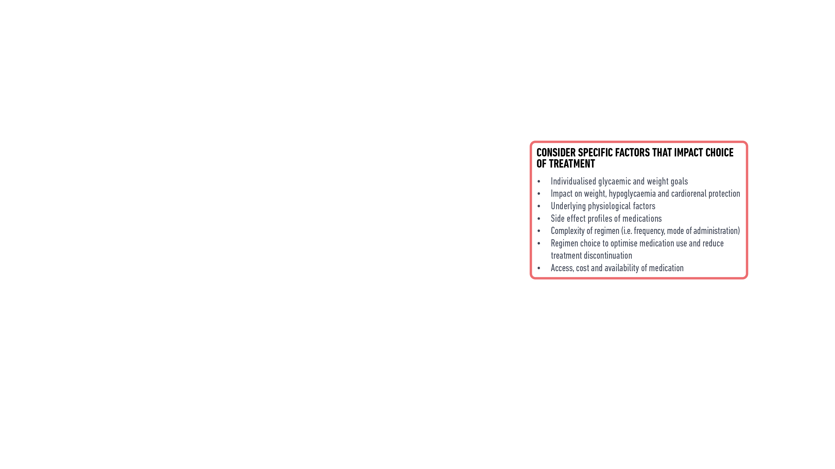

Davies MJ, Aroda VR, Collins BS, Gabbay RA, Green J, Maruthur NM, Rosas SE, Del Prato S, Mathieu C, Mingrone G, Rossing P, Tankova T, Tsapas A, Buse JB
Diabetes Care 2022; https://doi.org/10.2337/dci22-0034. Diabetologia 2022; https://doi.org/10.1007/s00125-022-05787-2.

Slide 28
Shared Decision-Making in Type 2 Diabetes
Shared decision-making can improve
  decision quality
  knowledge about risks, safety, and benefits
  incorporation of individual preferences and values when formulating a management plan
Ethical imperative for support of person’s autonomy
Davies MJ, Aroda VR, Collins BS, Gabbay RA, Green J, Maruthur NM, Rosas SE, Del Prato S, Mathieu C, Mingrone G, Rossing P, Tankova T, Tsapas A, Buse JB
Diabetes Care 2022; https://doi.org/10.2337/dci22-0034. Diabetologia 2022; https://doi.org/10.1007/s00125-022-05787-2.
.
Notes:
This can be facilitated by means of decision or conversational aids which have been shown to improve patient’s knowledge, satisfaction, risk awareness, decisional conflict and involvement. And although there is still little evidence supporting routine implementation of SDM at healthcare system scale, there is an ethical imperative for clinicians to support the autonomy of persons with diabetes and support them while making decisions together.

Slide 29
Diabetes Self-Management Education and Support (DSMES)
Face-to-face contact in group or individual sessions with trained educators
Promote healthy eating, physical activity, good medication-taking behavior, and increase self-efficacy
Theory based DSMES, with structured curriculum and contact time > 10 hrs
  decrease HbA_{1c}
  reduce hospital admissions
  improve person with diabetes knowledge
  improve clinical and psychological outcomes
  cost-effective
  potentially reduce the risk of all-cause mortality
Davies MJ, Aroda VR, Collins BS, Gabbay RA, Green J, Maruthur NM, Rosas SE, Del Prato S, Mathieu C, Mingrone G, Rossing P, Tankova T, Tsapas A, Buse JB
Diabetes Care 2022; https://doi.org/10.2337/dci22-0034. Diabetologia 2022; https://doi.org/10.1007/s00125-022-05787-2.
.

Slide 30
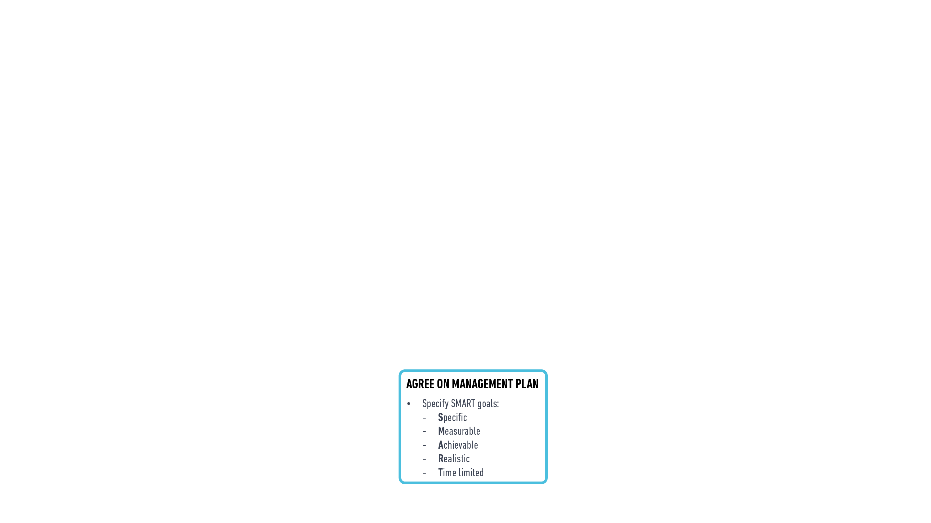

Davies MJ, Aroda VR, Collins BS, Gabbay RA, Green J, Maruthur NM, Rosas SE, Del Prato S, Mathieu C, Mingrone G, Rossing P, Tankova T, Tsapas A, Buse JB
Diabetes Care 2022; https://doi.org/10.2337/dci22-0034. Diabetologia 2022; https://doi.org/10.1007/s00125-022-05787-2.

Slide 31
Clinical Inertia
Clinical inertia: failure of healthcare providers to initiate or intensify therapy when indicated, due to:
  overestimation of care provided
  use of “soft” reasons to avoid intensification of therapy
  lack of education, training, and practice organisation aimed at achieving therapeutic goals
Davies MJ, Aroda VR, Collins BS, Gabbay RA, Green J, Maruthur NM, Rosas SE, Del Prato S, Mathieu C, Mingrone G, Rossing P, Tankova T, Tsapas A, Buse JB
Diabetes Care 2022; https://doi.org/10.2337/dci22-0034. Diabetologia 2022; https://doi.org/10.1007/s00125-022-05787-2.
.
Notes:
Moreover, it is important to be vigilant not to delay initiating or intensifying therapy when indicated, a phenomenon known as clinical inertia. Inertia may be considered in three areas. The first is over-estimation of care provided: healthcare professionals are over-estimating their adherence to guidelines and the care they provide. Healthcare professionals are often also providing “soft” reasons, to avoid intensification of treatment, including a perception that overall care of their patients is improving, and that there is non-adherence among patients and concerns about results from cardiovascular outcome trials. Finally, lack of training is a further reason for inertia, and many physicians lack the appropriate education and training needed to attain therapeutic goals.

Slide 32
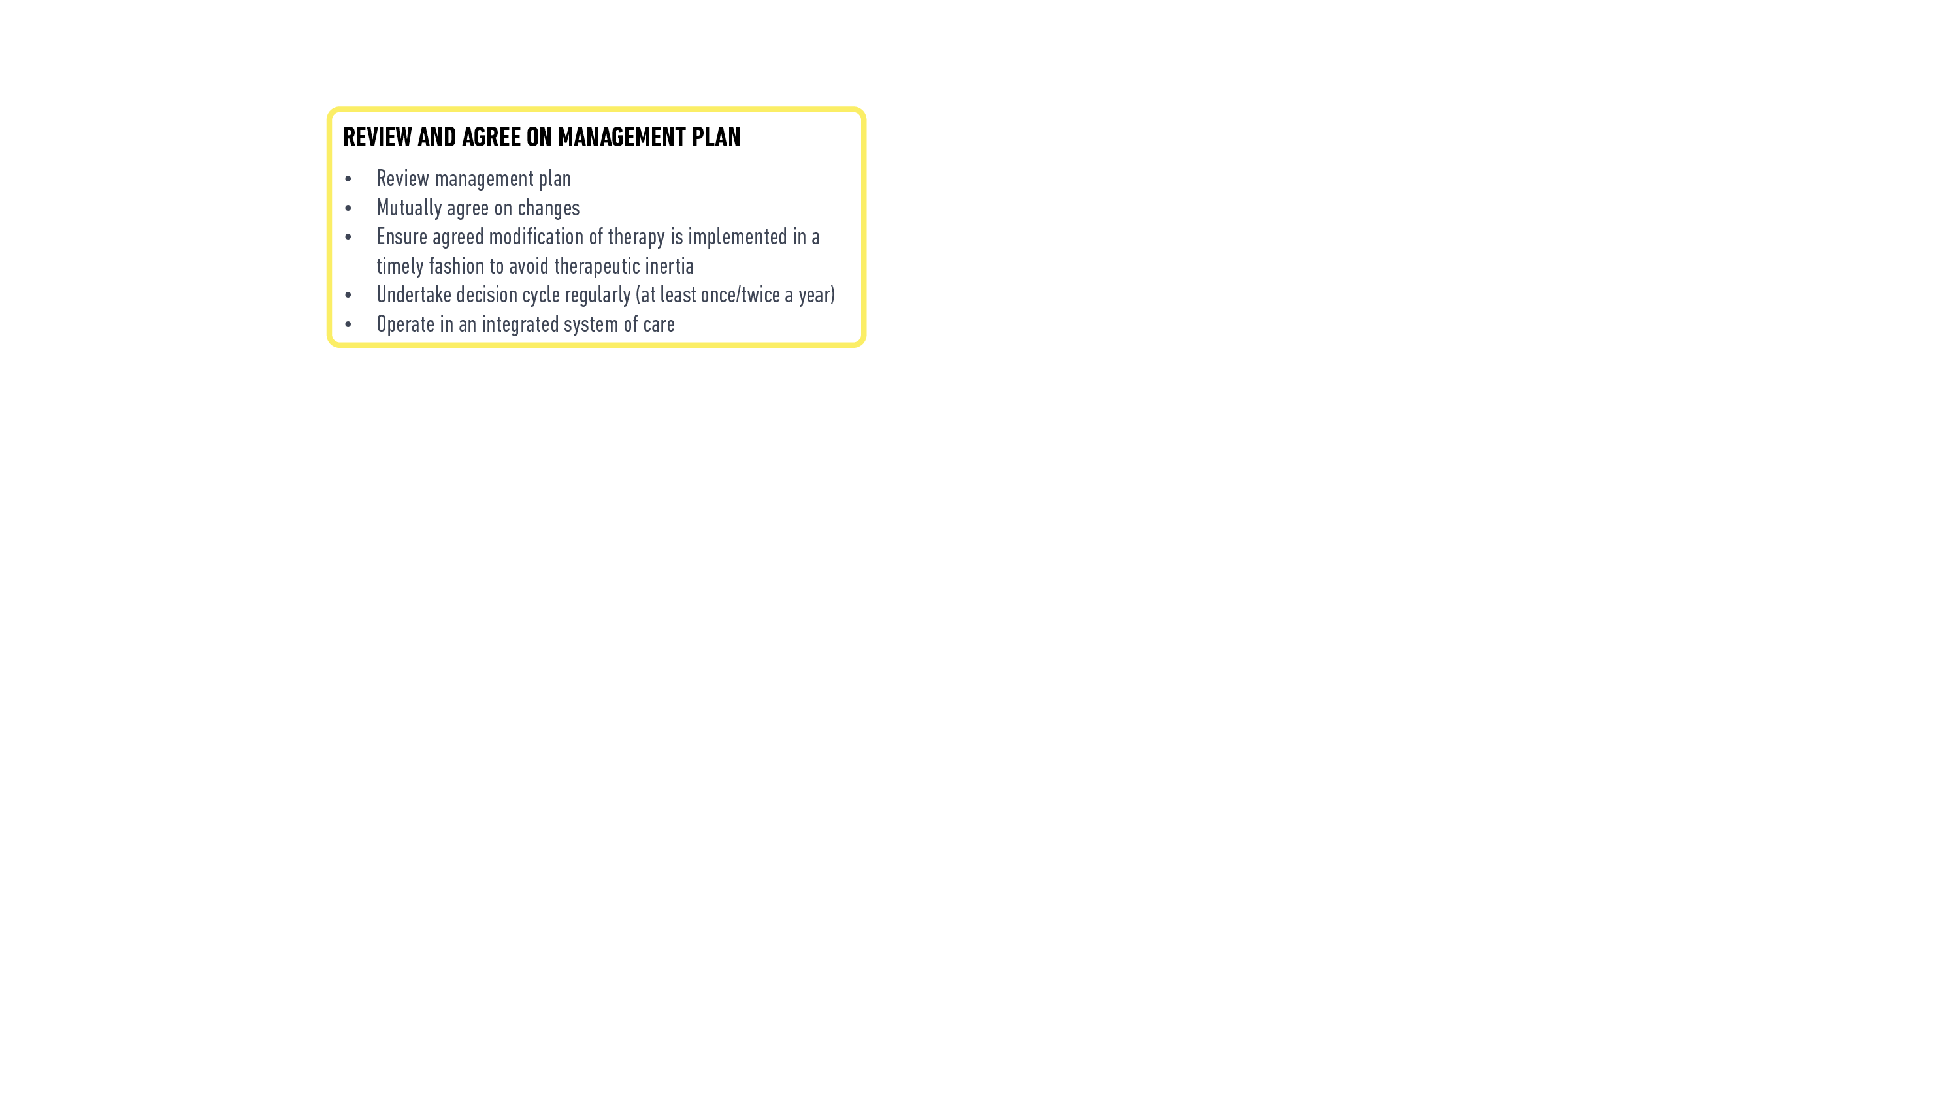
Davies MJ, Aroda VR, Collins BS, Gabbay RA, Green J, Maruthur NM, Rosas SE, Del Prato S, Mathieu C, Mingrone G, Rossing P, Tankova T, Tsapas A, Buse JB
Diabetes Care 2022; https://doi.org/10.2337/dci22-0034. Diabetologia 2022; https://doi.org/10.1007/s00125-022-05787-2.
.

Slide 33
Therapeutic Options: Lifestyle and Healthy Behaviour, Weight Management, and Pharmacotherapy for the Treatment of Type 2 Diabetes
Geltrude Mingrone, MD, PhD
Catholic University, Rome, Italy
King’s College, London, UK
Tsvetalina Tankova, MD, PhD, DMSc
Medical University, Sofia, Bulgaria
Vanita R. Aroda, MD
Director, Diabetes Clinical Research, Brigham and Women’s Hospital; Associate Professor of Medicine, Harvard Medical School
Davies MJ, Aroda VR, Collins BS, Gabbay RA, Green J, Maruthur NM, Rosas SE, Del Prato S, Mathieu C, Mingrone G, Rossing P, Tankova T, Tsapas A, Buse JB
Diabetes Care 2022; https://doi.org/10.2337/dci22-0034. Diabetologia 2022; https://doi.org/10.1007/s00125-022-05787-2.
Notes:
Geltrude: It is my pleasure to introduce this session on “….”. We enjoyed working internationally, collaboratively, and intensely on the evidence update for this section.

Slide 34
Disclosures of Interest
Geltrude Mingrone
Consultancy: Novo Nordisk, Fractyl Inc, Recor Inc, Keyron Ltd, Metadeq Inc.
Research grants: N/A
Tsvetalina Tankova
Consultancy and/or speaker’s bureau: Boehringer Ingelheim, Astra Zeneca, Eli Lilly, Sanofi, Novo Nordisk, MSD, Medtronic
Vanita R. Aroda
Consultancy: Applied Therapeutics, Duke, Fractyl, Novo Nordisk, Pfizer, Sanofi
Spouse is an employee of Janssen
Research Support (Institutional Contracts): Applied Therapeutics, Eli Lilly, Premier/Fractyl, Novo Nordisk, Sanofi

Slide 35
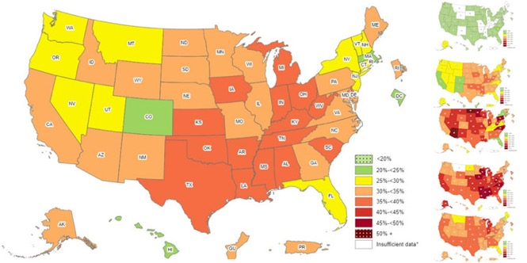
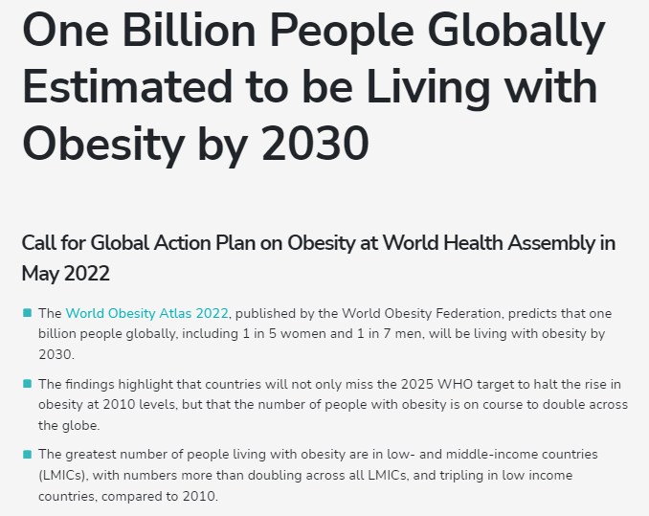
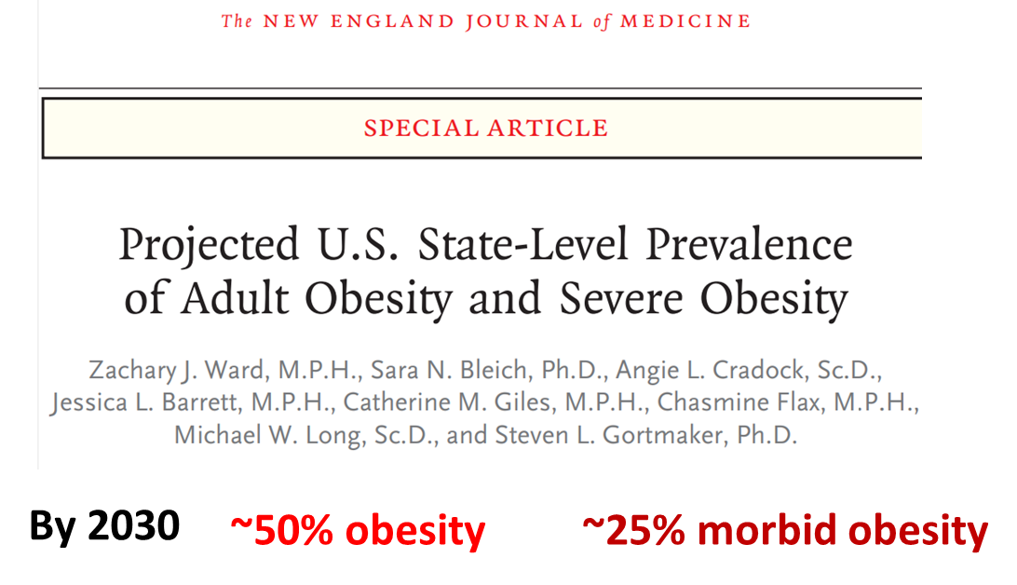

Ward ZJ et al; NEJM 2019; 381: 2440-2450
https://www.worldobesity.org/resources/resource-library/world-obesity-atlas-2022, Accessed 04 June, 2022
https://www.cdc.gov/obesity/data/prevalence-maps.html, Accessed 04 June, 2022
Notes:
Geltrude: Here’s another option to have both US and global information

Slide 36
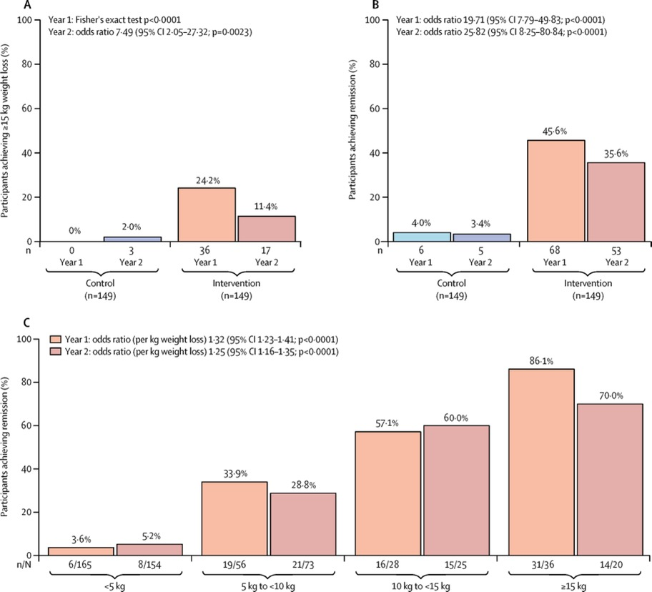
Intensive Structured Weight Management: the DiRect RCT
- 10 kg at 2 year follow-up = 64% diabetes remission
Lean et al. The Lancet Diabetes & Endocrinology 2019;7:344-355.

Slide 37
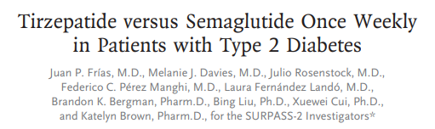
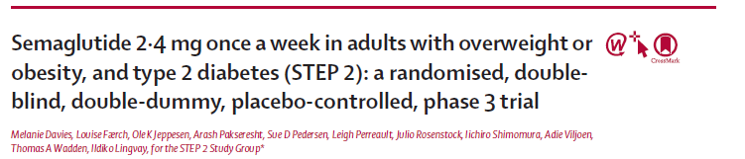
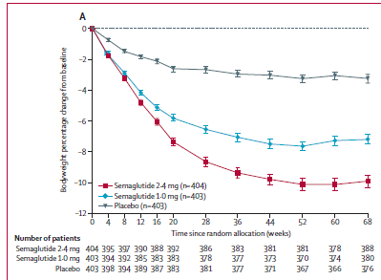
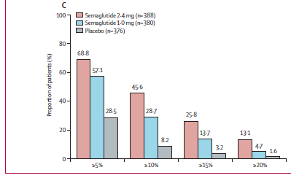
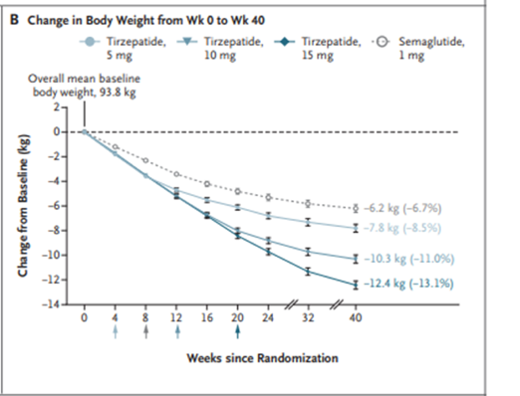
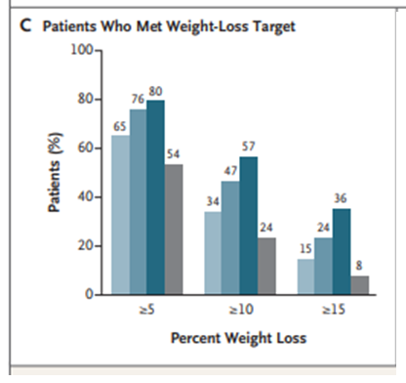
Weight Management in Type 2 Diabetes
Davies M et al; Lancet 2021; 397: 971-84
Frías JP et al. N Engl J Med 2021;385:503-515

Slide 38
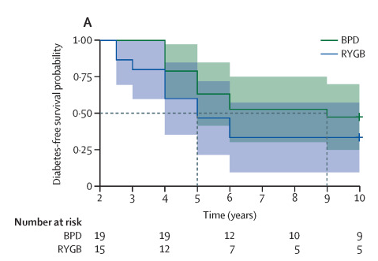
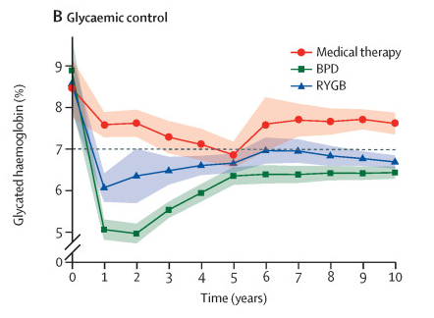
Weight Management: Metabolic Surgery
Mingrone et al. The Lancet. 2021 23;397:293-304

Slide 39
Davies MJ, Aroda VR, Collins BS, Gabbay RA, Green J, Maruthur NM, Rosas SE, Del Prato S, Mathieu C, Mingrone G, Rossing P, Tankova T, Tsapas A, Buse JB
Diabetes Care 2022; https://doi.org/10.2337/dci22-0034. Diabetologia 2022; https://doi.org/10.1007/s00125-022-05787-2.

Slide 40
Davies MJ, Aroda VR, Collins BS, Gabbay RA, Green J, Maruthur NM, Rosas SE, Del Prato S, Mathieu C, Mingrone G, Rossing P, Tankova T, Tsapas A, Buse JB
Diabetes Care 2022; https://doi.org/10.2337/dci22-0034. Diabetologia 2022; https://doi.org/10.1007/s00125-022-05787-2.

Slide 41
Davies MJ, Aroda VR, Collins BS, Gabbay RA, Green J, Maruthur NM, Rosas SE, Del Prato S, Mathieu C, Mingrone G, Rossing P, Tankova T, Tsapas A, Buse JB
Diabetes Care 2022; https://doi.org/10.2337/dci22-0034. Diabetologia 2022; https://doi.org/10.1007/s00125-022-05787-2.

Slide 42
Davies MJ, Aroda VR, Collins BS, Gabbay RA, Green J, Maruthur NM, Rosas SE, Del Prato S, Mathieu C, Mingrone G, Rossing P, Tankova T, Tsapas A, Buse JB
Diabetes Care 2022; https://doi.org/10.2337/dci22-0034. Diabetologia 2022; https://doi.org/10.1007/s00125-022-05787-2.

Slide 43
Davies MJ, Aroda VR, Collins BS, Gabbay RA, Green J, Maruthur NM, Rosas SE, Del Prato S, Mathieu C, Mingrone G, Rossing P, Tankova T, Tsapas A, Buse JB
Diabetes Care 2022; https://doi.org/10.2337/dci22-0034. Diabetologia 2022; https://doi.org/10.1007/s00125-022-05787-2.

Slide 44
Davies MJ, Aroda VR, Collins BS, Gabbay RA, Green J, Maruthur NM, Rosas SE, Del Prato S, Mathieu C, Mingrone G, Rossing P, Tankova T, Tsapas A, Buse JB
Diabetes Care 2022; https://doi.org/10.2337/dci22-0034. Diabetologia 2022; https://doi.org/10.1007/s00125-022-05787-2.

Slide 45
Davies MJ, Aroda VR, Collins BS, Gabbay RA, Green J, Maruthur NM, Rosas SE, Del Prato S, Mathieu C, Mingrone G, Rossing P, Tankova T, Tsapas A, Buse JB
Diabetes Care 2022; https://doi.org/10.2337/dci22-0034. Diabetologia 2022; https://doi.org/10.1007/s00125-022-05787-2.

Slide 46
Metformin
Traditionally recommended as first-line glucose-lowering therapy for type 2 diabetes, because of its high efficacy in lowering HbA_{1c}, minimal hypoglycaemia risk when used as monotherapy, potential for some modest weight loss, good safety profile, low cost
Davies MJ, Aroda VR, Collins BS, Gabbay RA, Green J, Maruthur NM, Rosas SE, Del Prato S, Mathieu C, Mingrone G, Rossing P, Tankova T, Tsapas A, Buse JB
Diabetes Care 2022; https://doi.org/10.2337/dci22-0034. Diabetologia 2022; https://doi.org/10.1007/s00125-022-05787-2.

Slide 47
Sulfonylureas
.
High glucose-lowering efficacy, inexpensive and accessible
A heterogenous group - sulfonylureas with lower risk of hypoglycaemia to be selected when considered for therapy
No difference in the incidence of MACE in patients at high CV risk treated with glimepiride or linagliptin
Davies MJ, Aroda VR, Collins BS, Gabbay RA, Green J, Maruthur NM, Rosas SE, Del Prato S, Mathieu C, Mingrone G, Rossing P, Tankova T, Tsapas A, Buse JB
Diabetes Care 2022; https://doi.org/10.2337/dci22-0034. Diabetologia 2022; https://doi.org/10.1007/s00125-022-05787-2.

Slide 48
Thiazolidinediones
High glucose-lowering efficacy, durability of glycaemic effect
Beneficial effects in NASH seen with pioglitazone
Side effects (e.g. weight gain, fluid retention) can be mitigated by optimising dosing strategies (e.g. using lower doses) and combining therapy with other medications (SGLT2 inhibitors, GLP-1 RA) that promote weight loss and sodium excretion
Davies MJ, Aroda VR, Collins BS, Gabbay RA, Green J, Maruthur NM, Rosas SE, Del Prato S, Mathieu C, Mingrone G, Rossing P, Tankova T, Tsapas A, Buse JB
Diabetes Care 2022; https://doi.org/10.2337/dci22-0034. Diabetologia 2022; https://doi.org/10.1007/s00125-022-05787-2.

Slide 49
DPP-4 Inhibitors
Intermediate glucose-lowering efficacy, neutral effect on weight, generally well tolerated, minimal risk of hypoglycaemia
Early combination treatment with metformin and a DPP-4i (vildagliptin) increased glycaemic durability compared to stepwise approach to therapy
Cardiovascular safety demonstrated
Davies MJ, Aroda VR, Collins BS, Gabbay RA, Green J, Maruthur NM, Rosas SE, Del Prato S, Mathieu C, Mingrone G, Rossing P, Tankova T, Tsapas A, Buse JB
Diabetes Care 2022; https://doi.org/10.2337/dci22-0034. Diabetologia 2022; https://doi.org/10.1007/s00125-022-05787-2.

Slide 50
SGLT2 Inhibitors
Glucose-lowering mechanism of action: Reduce renal tubular glucose reabsorption
Clinical Efficacy Profile: Intermediate to high glucose-lowering efficacy, lower at lower eGFR; low inherent risk of hypoglycaemia; intermediate weight loss
Cardiorenal Effects: Demonstrated protective effects in studied trial populations:
  Reduction in major adverse cardiovascular events
  Reduction in overall CV death (with heterogeneity across the class)
  Reduction in risk of hospitalisation for heart failure
  Reduction in risk of kidney outcomes
Increased confidence surrounding safety issues of interest
Davies MJ, Aroda VR, Collins BS, Gabbay RA, Green J, Maruthur NM, Rosas SE, Del Prato S, Mathieu C, Mingrone G, Rossing P, Tankova T, Tsapas A, Buse JB
Diabetes Care 2022; https://doi.org/10.2337/dci22-0034. Diabetologia 2022; https://doi.org/10.1007/s00125-022-05787-2.
.

Slide 51
GLP-1 Receptor Agonists
Glucose-lowering mechanism of action: Augment glucose-dependent insulin secretion & glucagon suppression, decelerate gastric emptying, curb post-meal glycaemic increments, reduce appetite, calorie intake and body weight
Clinical Efficacy Profile: High to Very High glucose-lowering efficacy, low inherent risk of hypoglycaemia; intermediate to high weight loss
Cardiorenal Effects: cardioprotective, with evidence of reduction in major adverse cardiovascular events, CV death, fatal or non-fatal MI, fatal or non-fatal stroke, all-cause mortality, composite kidney outcome driven by macroalbuminuria
Increased confidence surrounding safety areas of interest
Davies MJ, Aroda VR, Collins BS, Gabbay RA, Green J, Maruthur NM, Rosas SE, Del Prato S, Mathieu C, Mingrone G, Rossing P, Tankova T, Tsapas A, Buse JB
Diabetes Care 2022; https://doi.org/10.2337/dci22-0034. Diabetologia 2022; https://doi.org/10.1007/s00125-022-05787-2.

Slide 52
GLP-1 RA Therapeutic Updates
First oral GLP-1 RA (oral semaglutide) developed and available
Thethi TK et al; Diabetes Obes Metab; 2020; 22:1263-1277

Slide 53
GLP-1 RA Therapeutic Updates
First oral GLP-1 RA (oral semaglutide) developed and available
Higher dose GLP-1 RAs (dulaglutide, semaglutide) with incremental benefits in glucose weight efficacy
Greater clinical expertise in anticipating and addressing GI effects

Slide 54
Glucose-dependent insulinotropic polypeptide (GIP) receptor and GLP-1 receptor agonist (tirzepatide)
SURPASS-5
SURPASS-1
SURPASS-2
SURPASS-3
SURPASS-4
Rosenstock J et al; Lancet 2021; 398: 143-55
Frias JP et al; NEJM 2021;385:503-
Ludvik B et al; Lancet 2021; 398: 583–98
Del Prato S Kahn SE et al; Lancet 2021; 398:1811-1824
Dahl D et al; JAMA. 2022;327(6):534-545
Notes:
I can’t fit surpass 3 and 4 on here without making these too small.

Slide 55
Glucose-dependent insulinotropic polypeptide (GIP) receptor and GLP-1 receptor agonist (tirzepatide)
Glucose-lowering mechanism of action: GIP receptor and GLP-1 receptor agonist; enhances first and second-phase insulin secretion, and reduces glucagon levels, both in a glucose-dependent manner
Clinical Efficacy profile: Very high glycaemic efficacy; low inherent risk of hypoglycaemia; weight loss (high); cardiorenal effects unknown (trials in progress)
Davies MJ, Aroda VR, Collins BS, Gabbay RA, Green J, Maruthur NM, Rosas SE, Del Prato S, Mathieu C, Mingrone G, Rossing P, Tankova T, Tsapas A, Buse JB
Diabetes Care 2022; https://doi.org/10.2337/dci22-0034. Diabetologia 2022; https://doi.org/10.1007/s00125-022-05787-2.

Slide 56
Insulin
Advantage of lowering glucose in dose-dependent manner, able to address any level of glycaemia
Clinical Profile: High to very high glycaemic efficacy, increased risk of hypoglycaemia and weight gain; neutral cardiorenal profile
Efficacy and safety are largely dependent on education and support to facilitate self-management
Importance of matching insulin to physiologic need
Adapted from Hirsch I et al; Endocr Rev 2020; 41: 733-755
Davies MJ, Aroda VR, Collins BS, Gabbay RA, Green J, Maruthur NM, Rosas SE, Del Prato S, Mathieu C, Mingrone G, Rossing P, Tankova T, Tsapas A, Buse JB
Diabetes Care 2022; https://doi.org/10.2337/dci22-0034. Diabetologia 2022; https://doi.org/10.1007/s00125-022-05787-2.
Notes:
Figure X. Onset of action, peak action, and duration of action for various insulin formulations
Adapted from Hirsc IB et al; Endocrine Reviews 2020 41:733-755 (permission needed?)

Slide 57
Combination Therapy
Increasing evidence and rationale:
Increased durability of glycaemic effect, potential to address therapeutic inertia
Simultaneous targeting of multiple pathophysiologic processes characterised by type 2 diabetes
Potential impact on medication burden, adherence, and treatment persistence
Complementary clinical benefits (glycaemia, weight, cardiovascular risk profile)
Davies MJ, Aroda VR, Collins BS, Gabbay RA, Green J, Maruthur NM, Rosas SE, Del Prato S, Mathieu C, Mingrone G, Rossing P, Tankova T, Tsapas A, Buse JB
Diabetes Care 2022; https://doi.org/10.2337/dci22-0034. Diabetologia 2022; https://doi.org/10.1007/s00125-022-05787-2.

Slide 58
Davies MJ, Aroda VR, Collins BS, Gabbay RA, Green J, Maruthur NM, Rosas SE, Del Prato S, Mathieu C, Mingrone G, Rossing P, Tankova T, Tsapas A, Buse JB
Diabetes Care 2022; https://doi.org/10.2337/dci22-0034. Diabetologia 2022; https://doi.org/10.1007/s00125-022-05787-2.
Notes:
For revision suggestion: Metformin OR Agent with adequate EFFICACY to achieve and maintain glycemic goals OR Combination therapy
DPP4-I

Slide 59
Personalised Approach to Treatment Based on
Individual Characteristics and Comorbidities
Apostolos Tsapas, MD, PhD, MSc(Oxon)
Aristotle University of Thessaloniki
Thessaloniki, Greece
Jennifer Green, MD
Duke University School of Medicine
Durham, North Carolina USA
Davies MJ, Aroda VR, Collins BS, Gabbay RA, Green J, Maruthur NM, Rosas SE, Del Prato S, Mathieu C, Mingrone G, Rossing P, Tankova T, Tsapas A, Buse JB
Diabetes Care 2022; https://doi.org/10.2337/dci22-0034. Diabetologia 2022; https://doi.org/10.1007/s00125-022-05787-2.
Notes:
Good evening ladies and gentlemen. In our section Dr Green and myself will focus on the personalized approach based on individual characteristics and comorbidities.

Slide 60
Disclosures of Interest
Apostolos Tsapas declares the following (all fees paid to & handled by his institution):
Consultancy and/or speaker’s fees: Boehringer Ingelheim, Eli Lilly and Novo Nordisk
Research grants: Boehringer Ingelheim, Eli Lilly and Novo Nordisk
Stocks / Shareholder / Employee: None
Jennifer Green declares the following:
Consultant: AstraZeneca, Bayer AG, Boehringer Ingelheim International GmbH, Hawthorne Effect, Lexicon Pharmaceuticals, Inc., Lilly, Novo Nordisk, Omada Health, Inc., Pfizer Inc., Sanofi
Research Support: Boehringer Ingelheim International GmbH, Lexicon Pharmaceuticals, Inc., Lilly, Merck &amp; Co., Inc., Roche Diabetes Care, Sanofi
.
Notes:
These are our conflicts of interest.

Slide 61
Davies MJ, Aroda VR, Collins BS, Gabbay RA, Green J, Maruthur NM, Rosas SE, Del Prato S, Mathieu C, Mingrone G, Rossing P, Tankova T, Tsapas A, Buse JB
Diabetes Care 2022; https://doi.org/10.2337/dci22-0034. Diabetologia 2022; https://doi.org/10.1007/s00125-022-05787-2.
Notes:
As already presented, the decision for person-centered glycemic management in type 2 diabetes should be guided by key person characteristics, including clinical characteristics and comorbidities.

Slide 62
New evidence accrued after the last consensus update
Primary evidence
  Cardiovascular outcomes trials (AMPLITUDE-O, VERTIS CV, FREEDOM CVO)
  Heart failure trials (DAPA HF, SOLOIST-WHF, EMPEROR-Reduced, EMPEROR-Preserved)
  Renal outcomes trials (DAPA CKD, SCORED)
Secondary evidence
  Pairwise meta-analyses & syntheses of subgroup analyses (McGuire 2020, Sattar 2021, Neuen 2019, Neuen 2020, Tsapas 2021)
  Comparative effectiveness network meta-analyses (Tsapas 2020, Palmer 2021)
Davies MJ, Aroda VR, Collins BS, Gabbay RA, Green J, Maruthur NM, Rosas SE, Del Prato S, Mathieu C, Mingrone G, Rossing P, Tankova T, Tsapas A, Buse JB
Diabetes Care 2022; https://doi.org/10.2337/dci22-0034. Diabetologia 2022; https://doi.org/10.1007/s00125-022-05787-2.
Notes:
Recommendations presented are based on evidence utilised for the previous consensus papers but also new evidence that has systematically been accrued and appraised, including a series of cardiovascular, heart failure and renal trials, pairwise and comparative effectiveness network meta-analyses and finally syntheses of subgroup analyses.

Slide 63
Interpretation of syntheses of subgroup analyses
JAMA 2014;311(4):405-11
CMAJ 2020;192(32):E901-E906
.
Notes:
Credibility of the latter was assessed systematically and in duplicate, according to relevant guidance, to support formulation of recommendations which was informed by GRADE guidelines.

Slide 64
Davies MJ, Aroda VR, Collins BS, Gabbay RA, Green J, Maruthur NM, Rosas SE, Del Prato S, Mathieu C, Mingrone G, Rossing P, Tankova T, Tsapas A, Buse JB
Diabetes Care 2022; https://doi.org/10.2337/dci22-0034. Diabetologia 2022; https://doi.org/10.1007/s00125-022-05787-2.
.
Notes:
Based on existing evidence, we believe that choice of glucose lowering therapies that confer cardiorenal protection should be a component of care offered to certain high risk people with type 2 diabetes.

Slide 65
Choosing glucose-lowering medication in people with CVD
ASCVD = atherosclerotic cardiovascular disease
Davies MJ, Aroda VR, Collins BS, Gabbay RA, Green J, Maruthur NM, Rosas SE, Del Prato S, Mathieu C, Mingrone G, Rossing P, Tankova T, Tsapas A, Buse JB
Diabetes Care 2022; https://doi.org/10.2337/dci22-0034. Diabetologia 2022; https://doi.org/10.1007/s00125-022-05787-2.
Notes:
For people with established atherosclerotic cardiovascular disease or indicators of high risk our recommendation is to choose a GLP-1 receptor agonist or an SGLT-2 inhibitor with proven cardiovascular benefit. In case HbA1c remains above target one should add an agent from the other category or pioglitazone as deemed necessary. Our recommendation is based on the favourable results of cardiovascular outcomes trials that established the favourable effect of GLP-1 receptor agonists and SGLT-2 inhibitors on a series of hard clinical outcomes including major adverse cardiovascular events and all-cause mortality.

Slide 66
Consensus recommendations
In people with established CVD, a GLP-1RA with proven benefit should be used to reduce MACE or an SGLT2i with proven benefit should be used to reduce MACE and HF and improve kidney outcomes.
MACE = major adverse cardiovascular events
Davies MJ, Aroda VR, Collins BS, Gabbay RA, Green J, Maruthur NM, Rosas SE, Del Prato S, Mathieu C, Mingrone G, Rossing P, Tankova T, Tsapas A, Buse JB
Diabetes Care 2022; https://doi.org/10.2337/dci22-0034. Diabetologia 2022; https://doi.org/10.1007/s00125-022-05787-2.
Notes:
In particular, for people with established ASCVD, our recommendation is that a GLP-1RA with proven benefit should be used to reduce MACE, or an SGLT2i with proven benefit should be used to reduce MACE, HF and improve kidney outcomes.

Slide 67
Consensus recommendations
In people with established CVD, a GLP-1RA with proven benefit should be used to reduce MACE or an SGLT2i with proven benefit should be used to reduce MACE and HF and improve kidney outcomes.
In people without established CVD but with multiple cardiovascular risk factors (such as age ≥55, obesity, hypertension, smoking, dyslipidaemia, or albuminuria), a GLP-1RA with proven benefit could be used to reduce MACE or an SGLT2i with proven benefit could be used to reduce MACE and heart failure and improve kidney outcomes.
Davies MJ, Aroda VR, Collins BS, Gabbay RA, Green J, Maruthur NM, Rosas SE, Del Prato S, Mathieu C, Mingrone G, Rossing P, Tankova T, Tsapas A, Buse JB
Diabetes Care 2022; https://doi.org/10.2337/dci22-0034. Diabetologia 2022; https://doi.org/10.1007/s00125-022-05787-2.
Notes:
For people with multiple CV risk factors (such as age≥55, obesity, hypertension, smoking, dyslipidemia, or albuminuria) rather than established ASCVD our recommendation is that a GLP-1RA with proven benefit could be used to reduce MACE, or an SGLT2i with proven benefit could be used to reduce MACE, heart failure and improve kidney outcomes.

Slide 68
Evidence for patients with indicators of high CVD risk
Characteristics of subgroup analysis |  |  |  |  | Individual Assessment criteria: for all criteria except p-interaction value, imput value 1 to 4 (1=lowest credibility, 4=highest credibility) based on respective ICEMAN criteria
Effect modifier | Intervention | Outcome | Sources (PubMed IDs) | # RCTs | Type of comparison (i.e. between-trial, within-trial, meta-analysis of interactions) | For within-trial comparisons, is direction and magnitude of effect similar from trial to trial? | Use of random effects model within subgroups? | Additional criteria (e.g. 1 for sensitivity analysis corroborating estimate, or -1 point if sensitivity analysis alters effect estimate) | P-interaction value
ASCVD status | SGLT2i | MACE | 30424892 & 33031522 | 3/5 | 2 | 2 | 4 | -1 | 0.0501/0.63
ASCVD status | SGLT2i | CV mortality | 30424892 & 33031522 | 3/5 | 2 | 2 | 4 | -1 | 0.31/0.41
ASCVD status | SGLT2i | All-cause mortality | 30424892 & 33031522 | 3/5 | 2 | 3 | 4 | 1 | 0.69/0.64
ASCVD status | SGLT2i | Hospitalisation for heart failure | 30424892 & 33031522 | 3/5 | 2 | 3 | 4 | 1 | 0.38/0.26
ASCVD status | SGLT2i | Myocardial infarction | 30424892 & 33031522 | 3/5 | 2 | 2 | 4 | -1 | 0.17
ASCVD status | SGLT2i | Stroke | 30424892 & 33031522 | 3/5 | 2 | 2 | 4 | 1 | 0.83
ASCVD status | SGLT2i | Progression of renal disease | 30424892 & 33031522 | 3/5 | 2 | 3 | 4 | 1 | 0.71/0.73
ASCVD status | GLP1 RA | MACE | 31422062 & 31595657 & 34425083 | 7/7/ 8 | 3 | 2 | 4 | 0 | 0.24/0.50/0.18
BMJ 2021;372:m4573
.
Notes:
This recommendation is weaker compared to the one for patients with established cardiovascular disease as it was based only on subgroup analyses and linked to significantly lower absolute risk reductions, hence higher numbers needed to treat, due to lower baseline risk, and this point should be factored into the shared decision-making process.

Slide 69
Effect on MACE by background use of metformin or baseline HbA_{1c}
Lancet Diabetes Endocrinol 2021;9:653–62; JAMA Cardiol 2021;6(2):148-158
Diab Obes Metab 2021;23:382-390 Diabetes Res Clin Pract. 2021;177:108921 (updated)
Notes:
To explore the role of background use of metformin or baseline HbA1c as potential effect modifiers of cardiovascular benefit we used data from relevant recently published subgroup analyses. Effect on MACE or other cardiovascular outcomes did not appear to differ between people using vs. not using metformin or people with lower HbA1c and people with higher HbA1c at baseline, both with SGLT2i and with GLP-1RA.

Slide 70
Consensus recommendations
In people with HF, CKD, established CVD, or multiple risk factors for CVD, the decision to use a GLP-1RA or an SGLT2i with proven benefit should be independent of background use of metformin.
In people with HF, CKD, established CVD, or multiple risk factors for CVD, the decision to use a GLP-1RA or an SGLT2i with proven benefit should be independent of baseline HbA_{1c}.
Davies MJ, Aroda VR, Collins BS, Gabbay RA, Green J, Maruthur NM, Rosas SE, Del Prato S, Mathieu C, Mingrone G, Rossing P, Tankova T, Tsapas A, Buse JB
Diabetes Care 2022; https://doi.org/10.2337/dci22-0034. Diabetologia 2022; https://doi.org/10.1007/s00125-022-05787-2.
Notes:
Based on these data we concluded that in people with heart failure, CKD, established CVD or multiple risk factors for CVD, the decision to use a GLP-1RA or an SGLT2i with proven benefit should be independent of background use of metformin or baseline HbA1c.

Slide 71
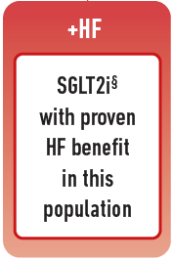
Choosing glucose-lowering medication in people with heart failure
In people with heart failure SGLT2i should be used because they improve heart failure and kidney outcomes.
Davies MJ, Aroda VR, Collins BS, Gabbay RA, Green J, Maruthur NM, Rosas SE, Del Prato S, Mathieu C, Mingrone G, Rossing P, Tankova T, Tsapas A, Buse JB
Diabetes Care 2022; https://doi.org/10.2337/dci22-0034. Diabetologia 2022; https://doi.org/10.1007/s00125-022-05787-2.
Notes:
For individuals with heart failure our recommendation is that SGLT2i with proven benefit should be used because they improve heart failure and kidney outcomes.

Slide 72
Effect of SGLT2i in people with heart failure
DAPA-HF
EMPEROR-PRESERVED
EMPEROR-REDUCED
N Engl J Med 2019;381:1995-2008
N Engl J Med 2021;385:1451-1461
N Engl J Med 2020;383:1413-1424
.
Notes:
This is based on the effect that has been demonstrated on a series of heart failure outcomes both in people with reduced ejection fraction (like in DAPA-HF or Emperor reduced), as well as in people with preserved ejection fraction (like in Emperor preserved),

Slide 73
Effect of SGLT2i in people with heart failure
Meta-analysis of HFrEF trials: First Kidney Outcome Composite
Kidney composite was defined as time to first occurrence of any of the components of 50% or higher sustained decline in eGFR, end-stage renal disease, or renal death. End-stage renal disease was defined as either sustained eGFR lower than 15 mL/min per 1·73 m², chronic dialysis treatment, or receiving a renal transplant.
Lancet 2020;396:819-29
Notes:
…as well as on the favourable effect on renal outcomes.
Now let me pass to my colleague Dr Green who will present our recommendations for people with CKD.

Slide 74
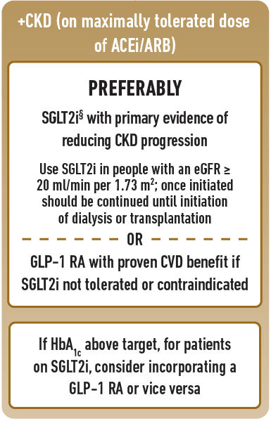
Choosing glucose-lowering medication in people with chronic kidney disease
Davies MJ, Aroda VR, Collins BS, Gabbay RA, Green J, Maruthur NM, Rosas SE, Del Prato S, Mathieu C, Mingrone G, Rossing P, Tankova T, Tsapas A, Buse JB
Diabetes Care 2022; https://doi.org/10.2337/dci22-0034. Diabetologia 2022; https://doi.org/10.1007/s00125-022-05787-2.
.

Slide 75
Effects of SGLT2i in people with chronic kidney disease
DM, diabetes mellitus; eGFR, estimated glomerular filtration rate; ESKD, end-stage kidney disease; TBD, to be determined; UACR, urinary albumin:creatinine ratio. a. Jardine MJ, et al. Am J Nephrol. 2017;46:462-472; b. ClinicalTrials.gov. Accessed November 09, 2021. https://clinicaltrials.gov/ct2/show/NCT02065791; c. Perkovic V, et al. N Engl J Med. 2019;380:2295-2306; d. ClinicalTrials.gov. Accessed November 09, 2021. https://clinicaltrials.gov/ct2/show/NCT03036150; e. Heerspink HJL, et al. Nephrol Dial Transplant. 2020;35:274-282; f. Heerspink HJL, et al. N Engl J Med. 2020;383:1436-1446; g. ClinicalTrials.gov. Accessed November 09, 2021. https://clinicaltrials.gov/ct2/show/ NCT03594110; h. Herrington WG, et al. Clin Kidney J. 2018;11:749-761. i. https://www.boehringer-ingelheim.com/human-health/metabolic-diseases/early-stop-chronic-kidney-disease-trial-efficacy
*published results not yet available
*
Davies MJ, Aroda VR, Collins BS, Gabbay RA, Green J, Maruthur NM, Rosas SE, Del Prato S, Mathieu C, Mingrone G, Rossing P, Tankova T, Tsapas A, Buse JB
Diabetes Care 2022; https://doi.org/10.2337/dci22-0034. Diabetologia 2022; https://doi.org/10.1007/s00125-022-05787-2.
.

Slide 76
Conclusions and recommendations
In people with CKD, SGLT-2 inhibitors and GLP-1RA reduce risk of MACE independent of eGFR.
In people with CKD, SGLT2i also reduce risks of HF and kidney outcomes (including end-stage kidney disease).
In people with CKD and eGFR≥ 20 ml/min per 1.73 m², an SGLT2i with proven benefit should be initiated to reduce risks of MACE, HF and kidney outcomes.
If such treatment is not tolerated or is contraindicated, a GLP-1RA with proven CV outcomes benefit could be considered
Davies MJ, Aroda VR, Collins BS, Gabbay RA, Green J, Maruthur NM, Rosas SE, Del Prato S, Mathieu C, Mingrone G, Rossing P, Tankova T, Tsapas A, Buse JB
Diabetes Care 2022; https://doi.org/10.2337/dci22-0034. Diabetologia 2022; https://doi.org/10.1007/s00125-022-05787-2.

Slide 77
Age
Additional Clinical Considerations
Type 2 diabetes and older age are associated with frailty, worse outcomes, and less benefit from intensive glycaemic control
Older (>65 years) and younger (<40 years) adults with diabetes are generally under-represented in clinical trials.
Therefore, informed decisions regarding treatment of older and younger individuals are limited by an absence of age-specific data
Diabetology 2022;3(1):30-45
Diabetes Res Clin Pract 2021;174:108737
Davies MJ, Aroda VR, Collins BS, Gabbay RA, Green J, Maruthur NM, Rosas SE, Del Prato S, Mathieu C, Mingrone G, Rossing P, Tankova T, Tsapas A, Buse JB
Diabetes Care 2022; https://doi.org/10.2337/dci22-0034. Diabetologia 2022; https://doi.org/10.1007/s00125-022-05787-2.

Slide 78
Age
However, a recent MA of 11 large GLP-1RA, SGLT2i outcomes trials found that CV and kidney outcomes in people aged ≥65 years were consistent with the effects seen in the overall trial population
Results in people <65 years and ≥65 years
Diabetology 2022;3(1):30-45
Diabetes Res Clin Pract 2021;174:108737
.

Slide 79
Age
Selection of medications to improve CV and kidney outcomes should not differ for older people
Medication choices for people who are frail or who have multiple comorbidities may require modification for safety and tolerability
Consider de-prescribing to avoid unnecessary medication and/or harmful side effects such as hypoglycaemia and hypotension
Davies MJ, Aroda VR, Collins BS, Gabbay RA, Green J, Maruthur NM, Rosas SE, Del Prato S, Mathieu C, Mingrone G, Rossing P, Tankova T, Tsapas A, Buse JB
Diabetes Care 2022; https://doi.org/10.2337/dci22-0034. Diabetologia 2022; https://doi.org/10.1007/s00125-022-05787-2.

Slide 80
Age
Rates of prediabetes and type 2 diabetes are increasing in the adolescent and young adult population, in concert with increases in obesity
Younger people with type 2 diabetes are at very high risk for complications, and should be treated correspondingly
Young people also have more rapid deterioration in glycaemic control and attenuated response to diabetes medications
JAMA Pediatr 2020;174(2):e194498
Diabetes Care 2018;41(8):1717-1725

Slide 81
Age
Early use of combination therapy to manage hyperglycaemia may be considered in young people with type 2 diabetes: VERIFY findings suggest superior and more durable glycaemic control with combination vs. metformin monotherapy
Primary treatment failure (HbA1c ≥ 7%) among people with young- and late-onset type 2 diabetes
Diabetes Obes Metab 2021;23(1):245-251
Notes:
Primary treatment failure among patients with young- and late-onset type 2 diabetes, randomized to early combination therapy ofvildagliptin and metformin versus initial metformin monotherapy followed by addition of vildagliptin with glycaemic worsening. CI, confidenceinterval; HR, hazard ratio. Primary treatment failure is defined as HbA1c≥7.0% at two consecutive scheduled visits, starting from 13 weeks afterrandomization. The time to initial treatment failure is the time from randomization to the second consecutive scheduled visits with HbA1c≥7.0%

Slide 82
Obesity and Weight-Related Comorbidities
Care of people with diabetes and weight-related comorbidities such as non-alcoholic fatty liver disease (NAFLD), HF, or obstructive sleep apnea (OSA) should include strategies to achieve weight loss
Davies MJ, Aroda VR, Collins BS, Gabbay RA, Green J, Maruthur NM, Rosas SE, Del Prato S, Mathieu C, Mingrone G, Rossing P, Tankova T, Tsapas A, Buse JB
Diabetes Care 2022; https://doi.org/10.2337/dci22-0034. Diabetologia 2022; https://doi.org/10.1007/s00125-022-05787-2.

Slide 83
Race, Ethnicity and Sex
Non-White people are disproportionately affected by type 2 diabetes and its complications
Women have a greater increase in relative risk of CVD from type 2 diabetes than men
These groups are consistently under-represented in clinical trials and generally have more poorly controlled CV risk factors
Available data suggest no significant between-group differences in treatment response: beneficial treatments should be utilised irrespective of a person’s race, ethnicity, and/or sex
JAMA Netw Open 2022;5(1):e2142078
Diabetes Care 2020;43(5):1157-1163
Davies MJ, Aroda VR, Collins BS, Gabbay RA, Green J, Maruthur NM, Rosas SE, Del Prato S, Mathieu C, Mingrone G, Rossing P, Tankova T, Tsapas A, Buse JB
Diabetes Care 2022; https://doi.org/10.2337/dci22-0034. Diabetologia 2022; https://doi.org/10.1007/s00125-022-05787-2.

Slide 84
Putting it all Together:
Strategies for Implementation
Chantal Mathieu, MD PhD
KU Leuven, Leuven, Belgium
Sylvia Rosas, MD, MSCE
Joslin Diabetes Center, Boston MA, USA
Nisa Maruthur, MD, MHS
Johns Hopkins University, Baltimore MD, USA
Davies MJ, Aroda VR, Collins BS, Gabbay RA, Green J, Maruthur NM, Rosas SE, Del Prato S, Mathieu C, Mingrone G, Rossing P, Tankova T, Tsapas A, Buse JB
Diabetes Care 2022; https://doi.org/10.2337/dci22-0034. Diabetologia 2022; https://doi.org/10.1007/s00125-022-05787-2.

Slide 85
Disclosures of Interest
Chantal Mathieu, MD, PhD
Advisory boards: Novo Nordisk, Sanofi, Merck Sharp and Dohme Ltd., Eli Lilly and Company, Novartis, AstraZeneca, Boehringer Ingelheim, Roche, Medtronic, ActoBio Therapeutics, Pfizer, Imcyse, Insulet, Zealand Pharma, Avotres, Mannkind, Sandoz and Vertex.
Speaker’s Bureau: Novo Nordisk, Sanofi, Eli Lilly and Company, Boehringer Ingelheim, Astra Zeneca and Novartis
Research support: Imcyse and ActoBio Therapeutics
Sylvia Rosas, MD, MSCE
Advisory boards: Bayer, Teladoc and AstraZeneca
Research support: Bayer, Astra Zeneca
Nisa Maruthur, MD, MHS
Advisory boards: None
Research support: None
.

Slide 86
Davies MJ, Aroda VR, Collins BS, Gabbay RA, Green J, Maruthur NM, Rosas SE, Del Prato S, Mathieu C, Mingrone G, Rossing P, Tankova T, Tsapas A, Buse JB
Diabetes Care 2022; https://doi.org/10.2337/dci22-0034. Diabetologia 2022; https://doi.org/10.1007/s00125-022-05787-2.

Slide 87
Davies MJ, Aroda VR, Collins BS, Gabbay RA, Green J, Maruthur NM, Rosas SE, Del Prato S, Mathieu C, Mingrone G, Rossing P, Tankova T, Tsapas A, Buse JB
Diabetes Care 2022; https://doi.org/10.2337/dci22-0034. Diabetologia 2022; https://doi.org/10.1007/s00125-022-05787-2.
.

Slide 88
Davies MJ, Aroda VR, Collins BS, Gabbay RA, Green J, Maruthur NM, Rosas SE, Del Prato S, Mathieu C, Mingrone G, Rossing P, Tankova T, Tsapas A, Buse JB
Diabetes Care 2022; https://doi.org/10.2337/dci22-0034. Diabetologia 2022; https://doi.org/10.1007/s00125-022-05787-2.

Slide 89
Davies MJ, Aroda VR, Collins BS, Gabbay RA, Green J, Maruthur NM, Rosas SE, Del Prato S, Mathieu C, Mingrone G, Rossing P, Tankova T, Tsapas A, Buse JB
Diabetes Care 2022; https://doi.org/10.2337/dci22-0034. Diabetologia 2022; https://doi.org/10.1007/s00125-022-05787-2.

Slide 90
Davies MJ, Aroda VR, Collins BS, Gabbay RA, Green J, Maruthur NM, Rosas SE, Del Prato S, Mathieu C, Mingrone G, Rossing P, Tankova T, Tsapas A, Buse JB
Diabetes Care 2022; https://doi.org/10.2337/dci22-0034. Diabetologia 2022; https://doi.org/10.1007/s00125-022-05787-2.

Slide 91
Davies MJ, Aroda VR, Collins BS, Gabbay RA, Green J, Maruthur NM, Rosas SE, Del Prato S, Mathieu C, Mingrone G, Rossing P, Tankova T, Tsapas A, Buse JB
Diabetes Care 2022; https://doi.org/10.2337/dci22-0034. Diabetologia 2022; https://doi.org/10.1007/s00125-022-05787-2.

Slide 92
Davies MJ, Aroda VR, Collins BS, Gabbay RA, Green J, Maruthur NM, Rosas SE, Del Prato S, Mathieu C, Mingrone G, Rossing P, Tankova T, Tsapas A, Buse JB
Diabetes Care 2022; https://doi.org/10.2337/dci22-0034. Diabetologia 2022; https://doi.org/10.1007/s00125-022-05787-2.

Slide 93
Davies MJ, Aroda VR, Collins BS, Gabbay RA, Green J, Maruthur NM, Rosas SE, Del Prato S, Mathieu C, Mingrone G, Rossing P, Tankova T, Tsapas A, Buse JB
Diabetes Care 2022; https://doi.org/10.2337/dci22-0034. Diabetologia 2022; https://doi.org/10.1007/s00125-022-05787-2.

Slide 94
Davies MJ, Aroda VR, Collins BS, Gabbay RA, Green J, Maruthur NM, Rosas SE, Del Prato S, Mathieu C, Mingrone G, Rossing P, Tankova T, Tsapas A, Buse JB
Diabetes Care 2022; https://doi.org/10.2337/dci22-0034. Diabetologia 2022; https://doi.org/10.1007/s00125-022-05787-2.

Slide 95
Davies MJ, Aroda VR, Collins BS, Gabbay RA, Green J, Maruthur NM, Rosas SE, Del Prato S, Mathieu C, Mingrone G, Rossing P, Tankova T, Tsapas A, Buse JB
Diabetes Care 2022; https://doi.org/10.2337/dci22-0034. Diabetologia 2022; https://doi.org/10.1007/s00125-022-05787-2.
.

Slide 96
Davies MJ, Aroda VR, Collins BS, Gabbay RA, Green J, Maruthur NM, Rosas SE, Del Prato S, Mathieu C, Mingrone G, Rossing P, Tankova T, Tsapas A, Buse JB
Diabetes Care 2022; https://doi.org/10.2337/dci22-0034. Diabetologia 2022; https://doi.org/10.1007/s00125-022-05787-2.

Slide 97
Davies MJ, Aroda VR, Collins BS, Gabbay RA, Green J, Maruthur NM, Rosas SE, Del Prato S, Mathieu C, Mingrone G, Rossing P, Tankova T, Tsapas A, Buse JB
Diabetes Care 2022; https://doi.org/10.2337/dci22-0034. Diabetologia 2022; https://doi.org/10.1007/s00125-022-05787-2.

Slide 98

Davies MJ, Aroda VR, Collins BS, Gabbay RA, Green J, Maruthur NM, Rosas SE, Del Prato S, Mathieu C, Mingrone G, Rossing P, Tankova T, Tsapas A, Buse JB
Diabetes Care 2022; https://doi.org/10.2337/dci22-0034. Diabetologia 2022; https://doi.org/10.1007/s00125-022-05787-2.

Slide 99
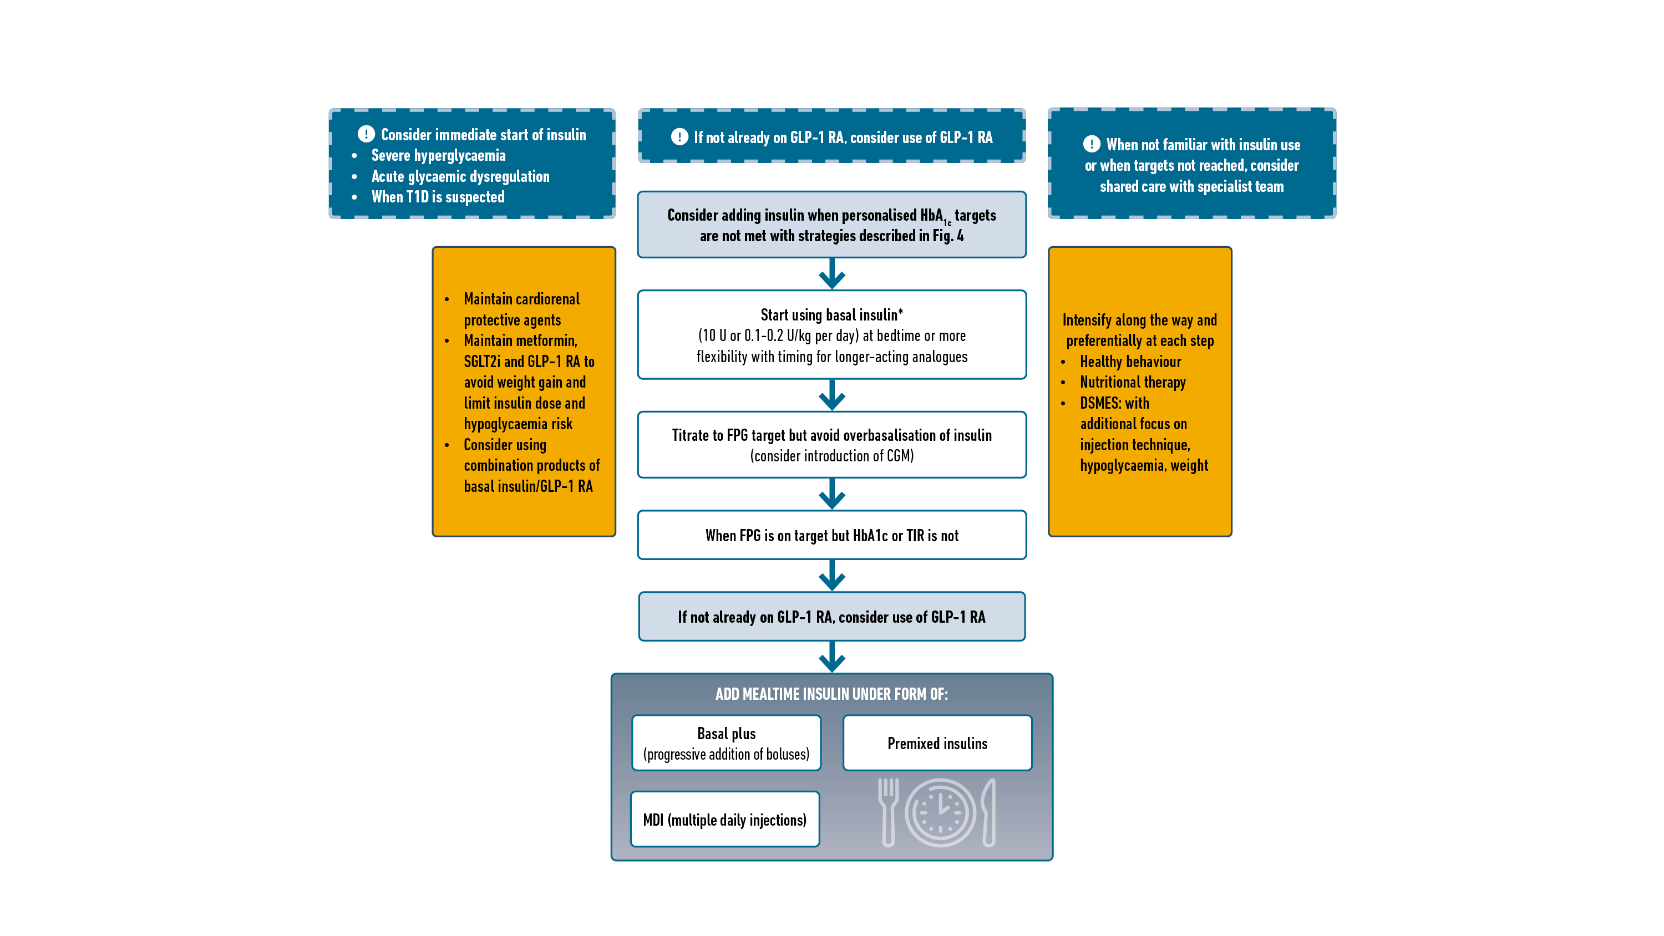
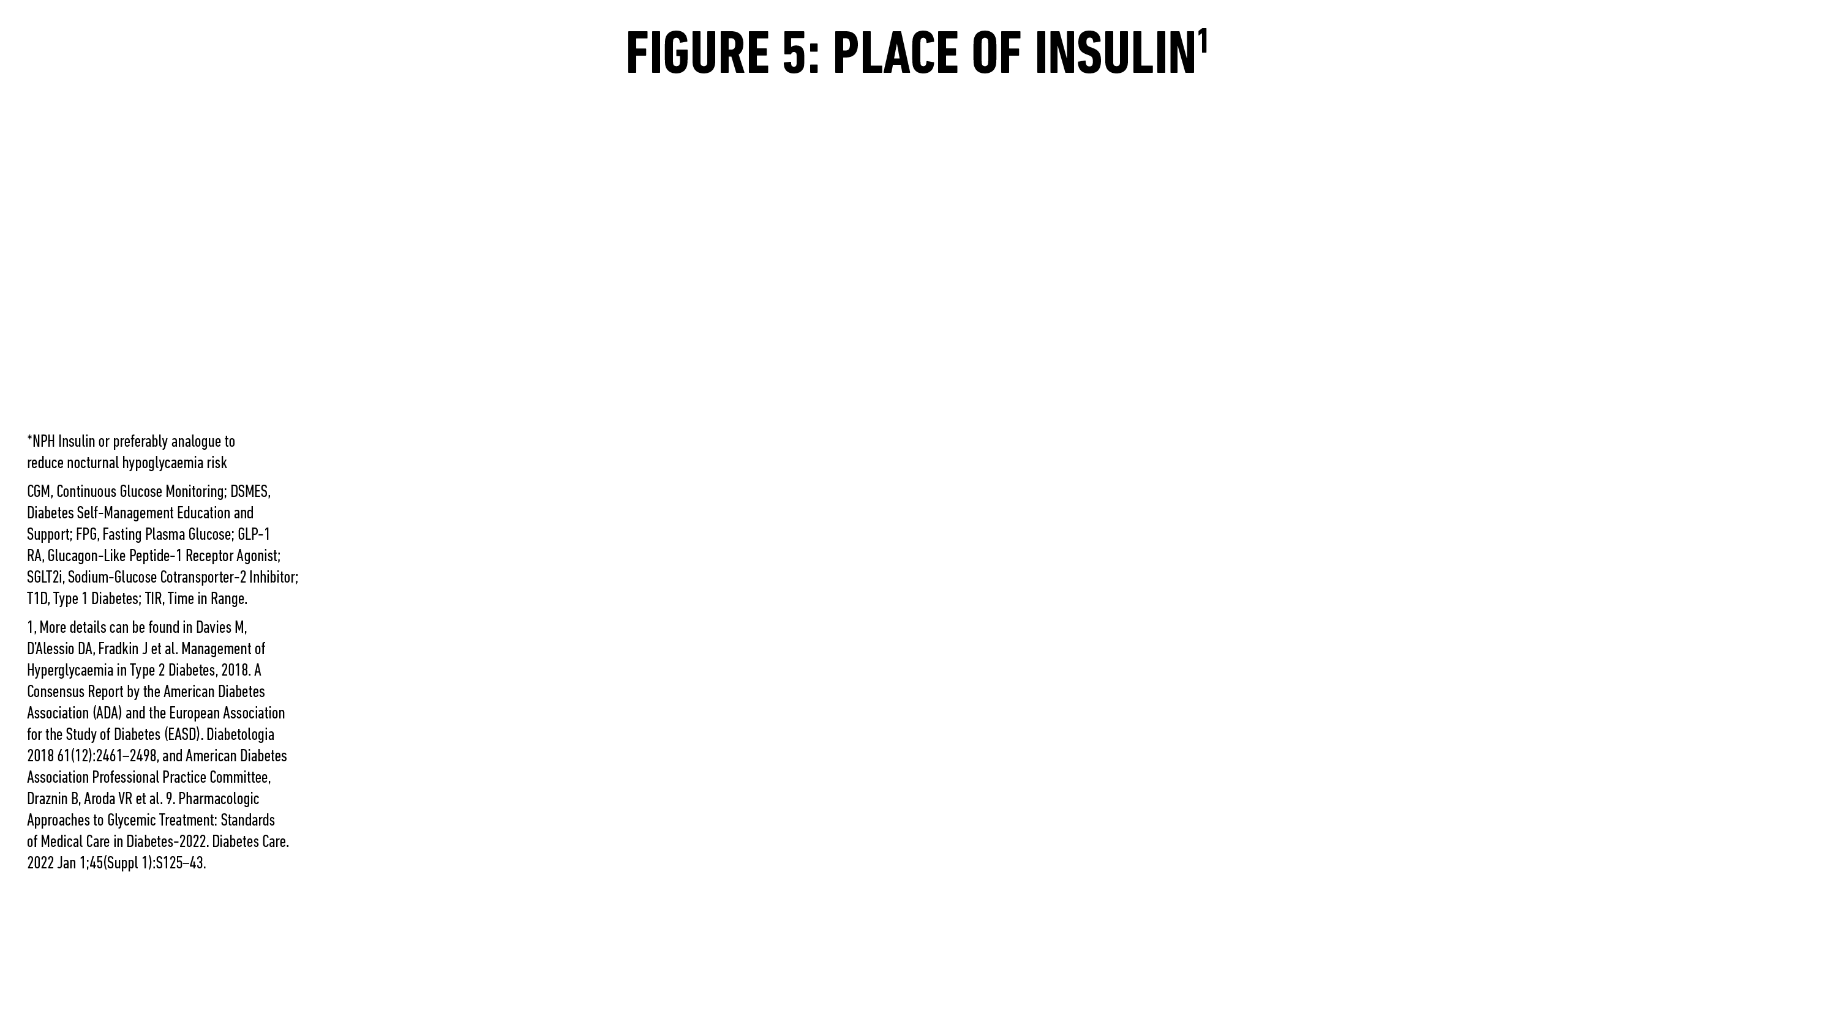
Davies MJ, Aroda VR, Collins BS, Gabbay RA, Green J, Maruthur NM, Rosas SE, Del Prato S, Mathieu C, Mingrone G, Rossing P, Tankova T, Tsapas A, Buse JB
Diabetes Care 2022; https://doi.org/10.2337/dci22-0034. Diabetologia 2022; https://doi.org/10.1007/s00125-022-05787-2.
.

Slide 100
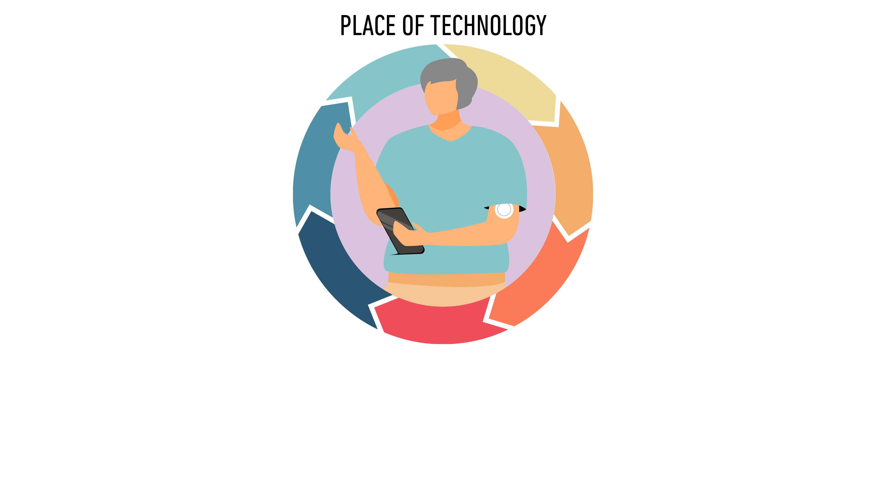

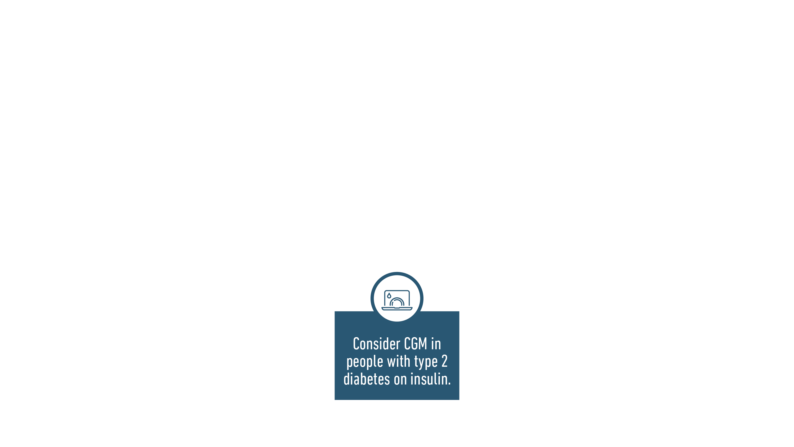

Davies MJ, Aroda VR, Collins BS, Gabbay RA, Green J, Maruthur NM, Rosas SE, Del Prato S, Mathieu C, Mingrone G, Rossing P, Tankova T, Tsapas A, Buse JB
Diabetes Care 2022; https://doi.org/10.2337/dci22-0034. Diabetologia 2022; https://doi.org/10.1007/s00125-022-05787-2.

Slide 101
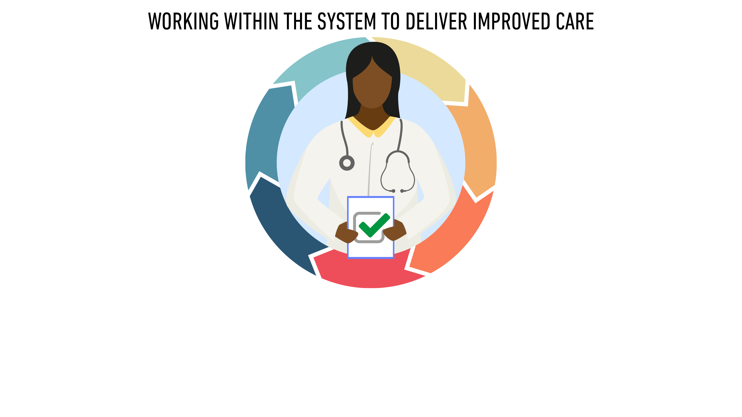

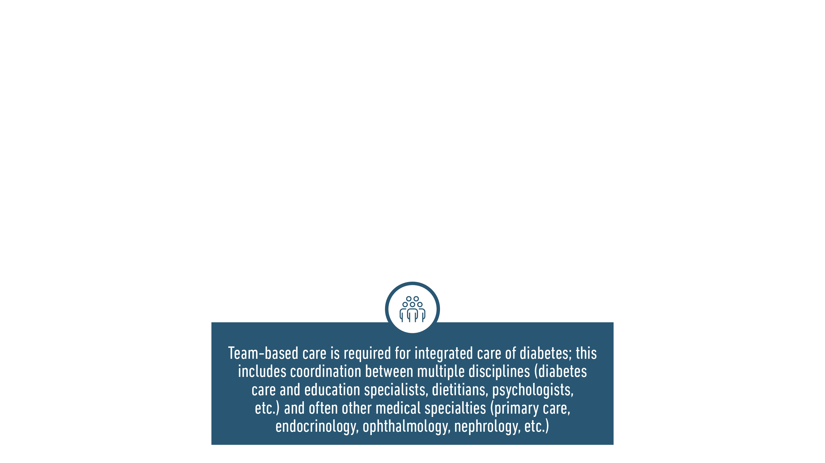
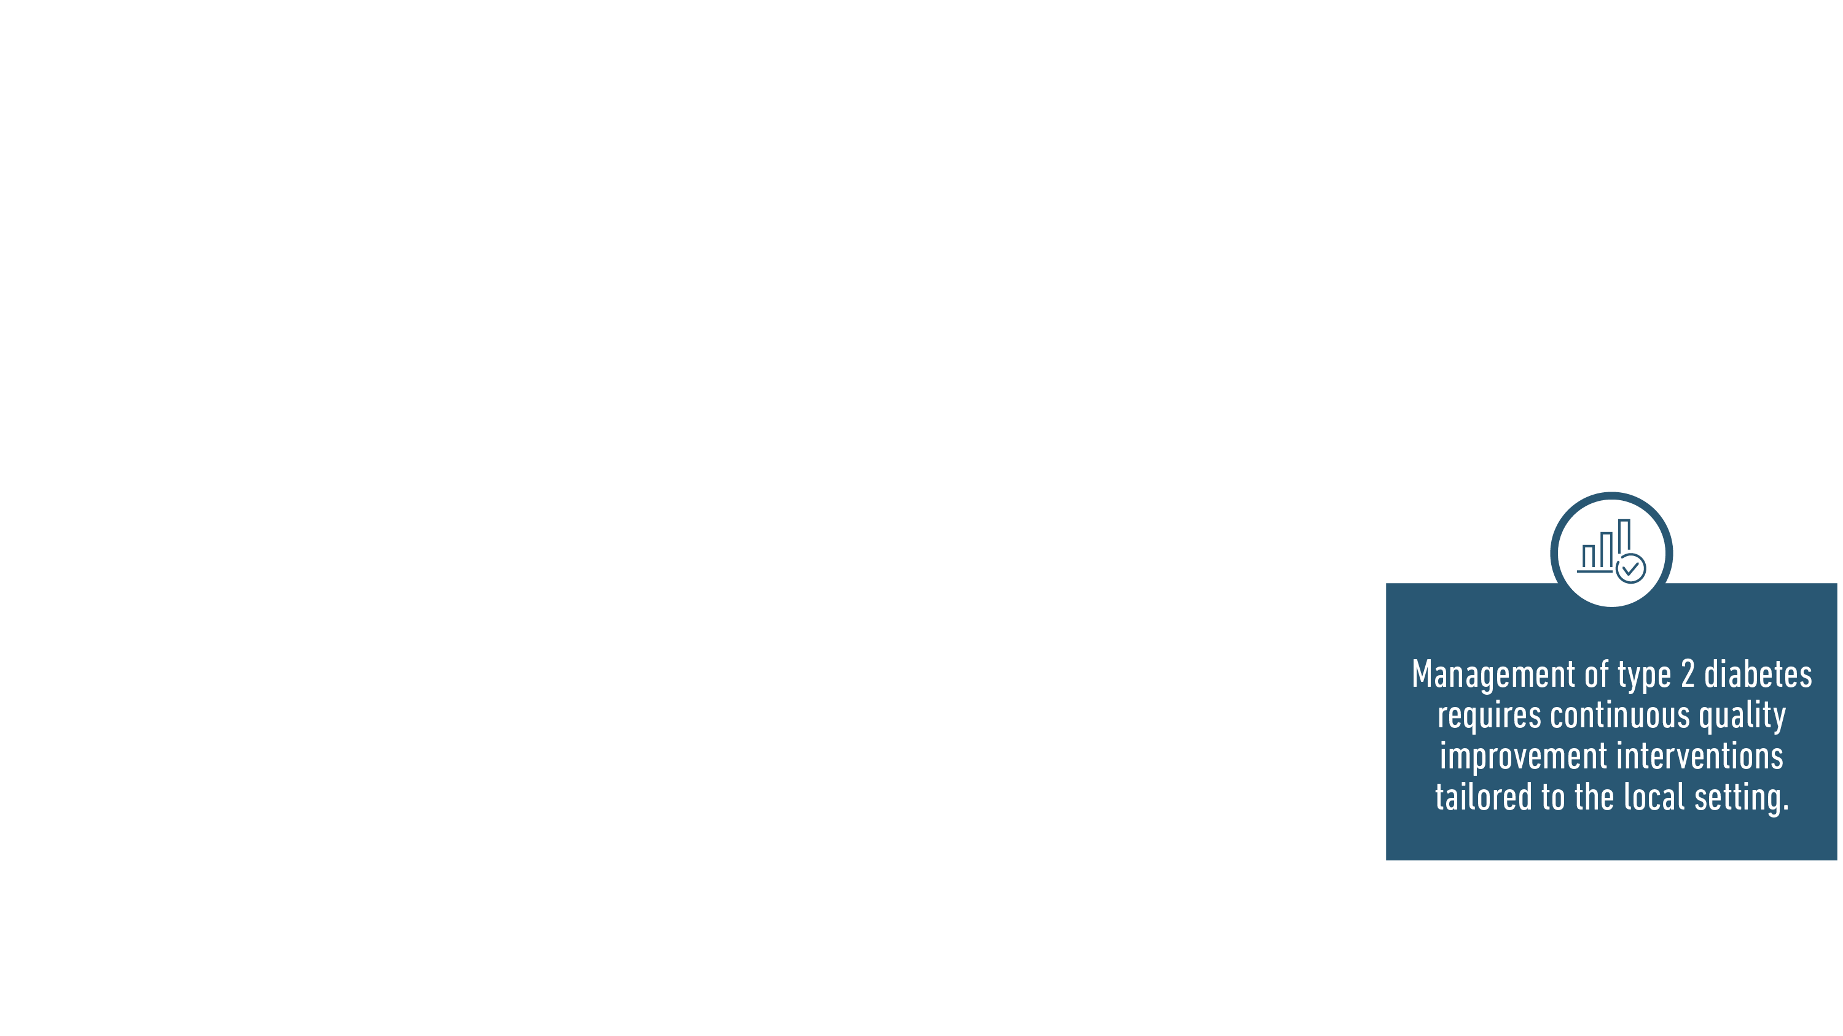
Davies MJ, Aroda VR, Collins BS, Gabbay RA, Green J, Maruthur NM, Rosas SE, Del Prato S, Mathieu C, Mingrone G, Rossing P, Tankova T, Tsapas A, Buse JB
Diabetes Care 2022; https://doi.org/10.2337/dci22-0034. Diabetologia 2022; https://doi.org/10.1007/s00125-022-05787-2.

Slide 102


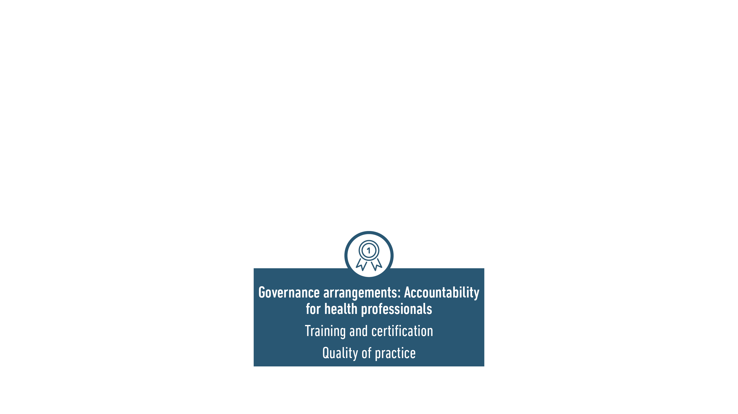


Davies MJ, Aroda VR, Collins BS, Gabbay RA, Green J, Maruthur NM, Rosas SE, Del Prato S, Mathieu C, Mingrone G, Rossing P, Tankova T, Tsapas A, Buse JB
Diabetes Care 2022; https://doi.org/10.2337/dci22-0034. Diabetologia 2022; https://doi.org/10.1007/s00125-022-05787-2.

Slide 103

Davies MJ, Aroda VR, Collins BS, Gabbay RA, Green J, Maruthur NM, Rosas SE, Del Prato S, Mathieu C, Mingrone G, Rossing P, Tankova T, Tsapas A, Buse JB
Diabetes Care 2022; https://doi.org/10.2337/dci22-0034. Diabetologia 2022; https://doi.org/10.1007/s00125-022-05787-2.
.

Slide 104
Key Knowledge Gaps and A Call to Action
John B Buse, MD, PhD
University of North Carolina School of Medicine
Chapel Hill, NC USA
Davies MJ, Aroda VR, Collins BS, Gabbay RA, Green J, Maruthur NM, Rosas SE, Del Prato S, Mathieu C, Mingrone G, Rossing P, Tankova T, Tsapas A, Buse JB
Diabetes Care 2022; https://doi.org/10.2337/dci22-0034. Diabetologia 2022; https://doi.org/10.1007/s00125-022-05787-2.

Slide 105
Disclosures of Interest
Advisory Panel/Consultant: Alkahest, Altimmune, Anji, AstraZeneca, Bayer, Biomea Fusion Inc, Boehringer-Ingelheim, CeQur, Cirius Therapeutics Inc, Dasman Diabetes Center (Kuwait), Eli Lilly, Fortress Biotech, GentiBio, Glycadia, Glyscend, Janssen, MannKind, Mediflix, Medscape, Mellitus Health, Moderna, Novo Nordisk, Pendulum Therapeutics, Praetego, Stability Health, Valo, Zealand Pharma
Research Support: Dexcom, NovaTarg, Novo Nordisk, Sanofi, Tolerion and vTv Therapeutics
Speaker’s Bureau: None
Employee: None
Stocks/Shareholder: Glyscend, Mellitus Health, Pendulum Therapeutics, PhaseBio, Praetego, and Stability Health
.

Slide 106
Call to Action
Reflecting on the discovery of insulin 100 years ago and the experience over the last 3 years with COVID-19
The major opportunities to improve diabetes outcomes in the near term come from more effective implementation of best evidence through organisation of care at all levels (national to individual practices) and from addressing social determinants of health
Everyone has a role to play in better implementation with a focus on equity
Davies MJ, Aroda VR, Collins BS, Gabbay RA, Green J, Maruthur NM, Rosas SE, Del Prato S, Mathieu C, Mingrone G, Rossing P, Tankova T, Tsapas A, Buse JB
Diabetes Care 2022; https://doi.org/10.2337/dci22-0034. Diabetologia 2022; https://doi.org/10.1007/s00125-022-05787-2.

Slide 107
Key Opportunities
Basic science to bring the next generation of interventions
Implementation science is an essential area for future work, particularly in the context of “learning health care systems” in which internal data is systematically integrated with published evidence to drive quality improvement
Precision medicine initiatives, whether “omics”-based or focused on social determinants of health, aim to optimally target interventions based on the wide heterogeneity of the population affected by diabetes
Individualising care to make sure that the right person is getting the right therapy at the right time independent of social determinants of health
Davies MJ, Aroda VR, Collins BS, Gabbay RA, Green J, Maruthur NM, Rosas SE, Del Prato S, Mathieu C, Mingrone G, Rossing P, Tankova T, Tsapas A, Buse JB
Diabetes Care 2022; https://doi.org/10.2337/dci22-0034. Diabetologia 2022; https://doi.org/10.1007/s00125-022-05787-2.
.
Notes:
The tools available to prevent and treat diabetes are vastly improved However, implementation of effective innovation has lagged behind and requires fundamental changes in health care policy and societal approaches to wellness
Our understanding of the basic mechanisms of diabetes, the development of complications, and the treatment of both, though continuously advancing, has highlighted how much we do not know
Current therapy of overweight/obesity is clearly inadequate
Lifestyle management and diabetes self-management education and support is of clear benefit, yet current paradigms on how to apply the broad approaches need to be better targeted and individualized
Preserving and enhancing beta-cell function is perceived as the holy grail of diabetes and yet effective techniques are inadequately developed
The promise of personalized medicine and –omics approaches addressing both personal and environmental factors and their interaction is largely unrealized in diabetes care and will require large investments and coordination to reach application in the form of enhanced biomarkers and tailored treatments
There is a gap between what we know from trial data and what happens in clinical practice We need better devised trials which include measures of patient preference and patient-recorded outcome measures Better application of “real-world evidence” to complement traditional RCT evidence is needed to impact patient outcomes

Slide 108
Key Knowledge Gaps
Study conduct
  Greater attention to subgroups, in particular vulnerable populations
    Youth, frailty, >75 years of age
    Gender balance
  A minimal first step to enhancing health justice
Weight management
  Comparative effectiveness
Targets: A1c, TIR, weight, remission
Cardiorenal protection
  Comparative effectiveness, Combination therapy, Cost effectiveness in low/moderate risk population
Davies MJ, Aroda VR, Collins BS, Gabbay RA, Green J, Maruthur NM, Rosas SE, Del Prato S, Mathieu C, Mingrone G, Rossing P, Tankova T, Tsapas A, Buse JB
Diabetes Care 2022; https://doi.org/10.2337/dci22-0034. Diabetologia 2022; https://doi.org/10.1007/s00125-022-05787-2.
Notes:
The tools available to prevent and treat diabetes are vastly improved However, implementation of effective innovation has lagged behind and requires fundamental changes in health care policy and societal approaches to wellness
Our understanding of the basic mechanisms of diabetes, the development of complications, and the treatment of both, though continuously advancing, has highlighted how much we do not know
Current therapy of overweight/obesity is clearly inadequate
Lifestyle management and diabetes self-management education and support is of clear benefit, yet current paradigms on how to apply the broad approaches need to be better targeted and individualized
Preserving and enhancing beta-cell function is perceived as the holy grail of diabetes and yet effective techniques are inadequately developed
The promise of personalized medicine and –omics approaches addressing both personal and environmental factors and their interaction is largely unrealized in diabetes care and will require large investments and coordination to reach application in the form of enhanced biomarkers and tailored treatments
There is a gap between what we know from trial data and what happens in clinical practice We need better devised trials which include measures of patient preference and patient-recorded outcome measures Better application of “real-world evidence” to complement traditional RCT evidence is needed to impact patient outcomes

Slide 109
Key Knowledge Gaps
Study conduct
  Greater attention to subgroups, in particular vulnerable populations
    Youth, frailty, >75 years of age
    Gender balance
  A minimal first step to enhancing health justice
Weight management
  Comparative effectiveness
Targets: A1c, TIR, weight, remission
Cardiorenal protection
  Comparative effectiveness, Combination therapy, Cost effectiveness in low/moderate risk population
Glucose monitoring
Comorbidities
  NAFLD
  Cognitive impairment
  Advanced CKD
Screening and prevention
Technology
Sleep and chronotype
Davies MJ, Aroda VR, Collins BS, Gabbay RA, Green J, Maruthur NM, Rosas SE, Del Prato S, Mathieu C, Mingrone G, Rossing P, Tankova T, Tsapas A, Buse JB
Diabetes Care 2022; https://doi.org/10.2337/dci22-0034. Diabetologia 2022; https://doi.org/10.1007/s00125-022-05787-2.
Notes:
The tools available to prevent and treat diabetes are vastly improved However, implementation of effective innovation has lagged behind and requires fundamental changes in health care policy and societal approaches to wellness
Our understanding of the basic mechanisms of diabetes, the development of complications, and the treatment of both, though continuously advancing, has highlighted how much we do not know
Current therapy of overweight/obesity is clearly inadequate
Lifestyle management and diabetes self-management education and support is of clear benefit, yet current paradigms on how to apply the broad approaches need to be better targeted and individualized
Preserving and enhancing beta-cell function is perceived as the holy grail of diabetes and yet effective techniques are inadequately developed
The promise of personalized medicine and –omics approaches addressing both personal and environmental factors and their interaction is largely unrealized in diabetes care and will require large investments and coordination to reach application in the form of enhanced biomarkers and tailored treatments
There is a gap between what we know from trial data and what happens in clinical practice We need better devised trials which include measures of patient preference and patient-recorded outcome measures Better application of “real-world evidence” to complement traditional RCT evidence is needed to impact patient outcomes

Slide 110
Overall Summary
Empathic, person-centred decision-making and support informed by an understanding of local resources and individual social determinants of health
Consistent efforts to improve health behaviours (nutrition, activity, sleep, self-monitoring) and to provide diabetes self-management education and support
Acceptance, adherence, and persistence with medical interventions to support cardiorenal health, cardiovascular risk reduction, and attainment of glycaemic and weight goals will prevent complications and optimise quality of life
We must establish and refine quality improvement efforts in diabetes care at the local level to equitably implement evidence-based interventions to the benefit of all people with type 2 diabetes
Davies MJ, Aroda VR, Collins BS, Gabbay RA, Green J, Maruthur NM, Rosas SE, Del Prato S, Mathieu C, Mingrone G, Rossing P, Tankova T, Tsapas A, Buse JB
Diabetes Care 2022; https://doi.org/10.2337/dci22-0034. Diabetologia 2022; https://doi.org/10.1007/s00125-022-05787-2.
.

Slide 111
Co-Chair: Melanie J. Davies MB ChB, MD
University of Leicester, UK
Co-Chair: John B. Buse, MD, PhD
UNC School of Medicine, USA
The Rationale
Peter Rossing, MD
Steno Diabetes Center Copenhagen, Denmark
Billy Collins, DHSc, PA-C
U.S. Public Health Service, USA
Personalised Approach
Apostolos Tsapas, MD, PhD, MSc
Aristotle University Thessaloniki, Greece
Jennifer Green, MD
Duke University, Durham, USA
Project Oversight & Integration with SOC Mindy Saraco & Malaika Hill
ADA
Support Across Groups
Robert Gabbay, MD, PhD
ADA
Stefano Del Prato, MD
EASD
Strategies for Implementation
Chantal Mathieu, MD, PhD
KU Leuven, Leuven, Belgium
Nisa Maruthur, MD, MHS
Johns Hopkins Medicine, Baltimore, USA
Sylvia Rosas, MD, MSCE
Joslin Diabetes Center, Boston, USA
Therapeutic Options
Vanita Aroda, MD
Brigham & Women's Hospital, Boston, USA
Geltrude Mingrone, MD, PhD
Catholic University of the Sacred heart, Rome, Italy
Tsvetalina Tankova, MD, DSC
Medical University, Sofia, Bulgaria
Davies MJ, Aroda VR, Collins BS, Gabbay RA, Green J, Maruthur NM, Rosas SE, Del Prato S, Mathieu C, Mingrone G, Rossing P, Tankova T, Tsapas A, Buse JB
Diabetes Care 2022; https://doi.org/10.2337/dci22-0034. Diabetologia 2022; https://doi.org/10.1007/s00125-022-05787-2.
.

Slide 112
Acknowledgements
From Leicester Diabetes Centre, the University of Leicester and the NHS Hospital Trust (UHL University of Leicester NHS Trust):
Michael Bonar
Charlie Franklin
Shehnaz Jamal
Francesco Zaccardi
Joe Henson
Tom Yates
From Aristotle University Thessaloniki
Thomas Karagiannis
ADA
Malaika Hill
Raveendhara R. Bannuru, MD, FAGE
Nuha El Sayed, MD, MMSc
EASD
Petra Niemann
Natasha Buckley-Muehge
Invited Reviewers
CCA of the EASD
PPC of the ADA
.

Slide 113
Invited Reviewers
D Bradley (Columbus, OH), P Home (Newcastle, UK), M S Kirkman (Chapel Hill, NC),
S Dinneen (Galway, Ireland), HW Rodbard (Rockville, MD), G Sesti (Rome, Italy),
P Newland-Jones (Southampton, UK), E Montanya (Barcelona, Spain),
M Nauck (Bochum, Germany)

Slide 114
Copies of the manuscript and slides are available at
For today only
https://diabetologia-journal.org/wpcontent/uploads/2022/09/ADAEASDConsensusReport.pdf
Consensus report (EASD): https://doi.org/10.1007/s00125-022-05787-2
Slide deck (EASD): https://tinyurl.com/ysxjwtm3
Consensus report (ADA): https://doi.org/10.2337/dci22-0034
Slide deck (ADA): https://professional.diabetes.org/2022ADA/EASDconsensus

